Slide 1
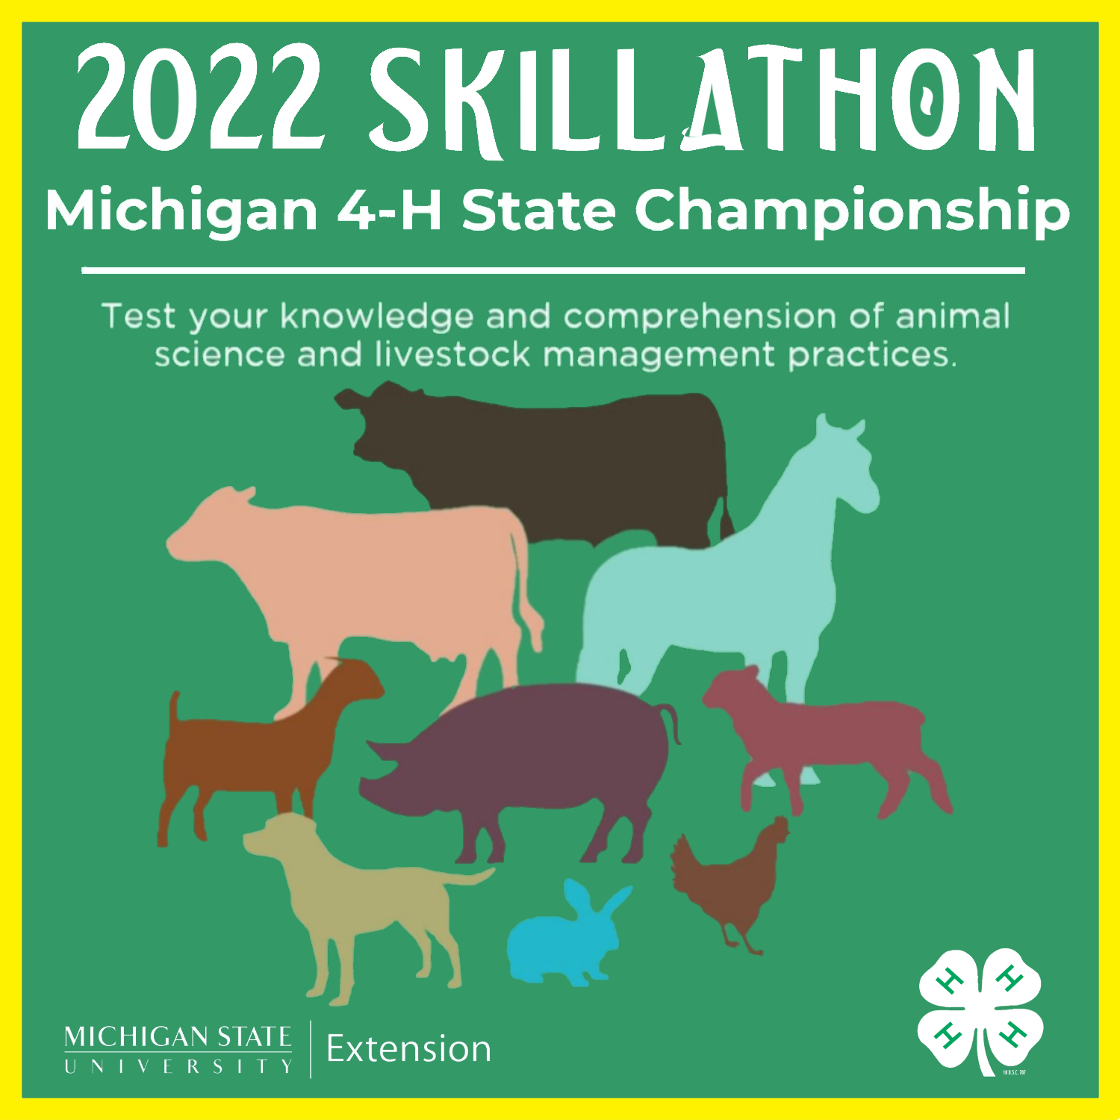
AWARDS
PRESENTATION
March 22, 2022

Slide 2
Skillathon Fast Facts
  145 Contestants
  36 Counties
  4 Age Divisions
  Repeat Champions?

Slide 3
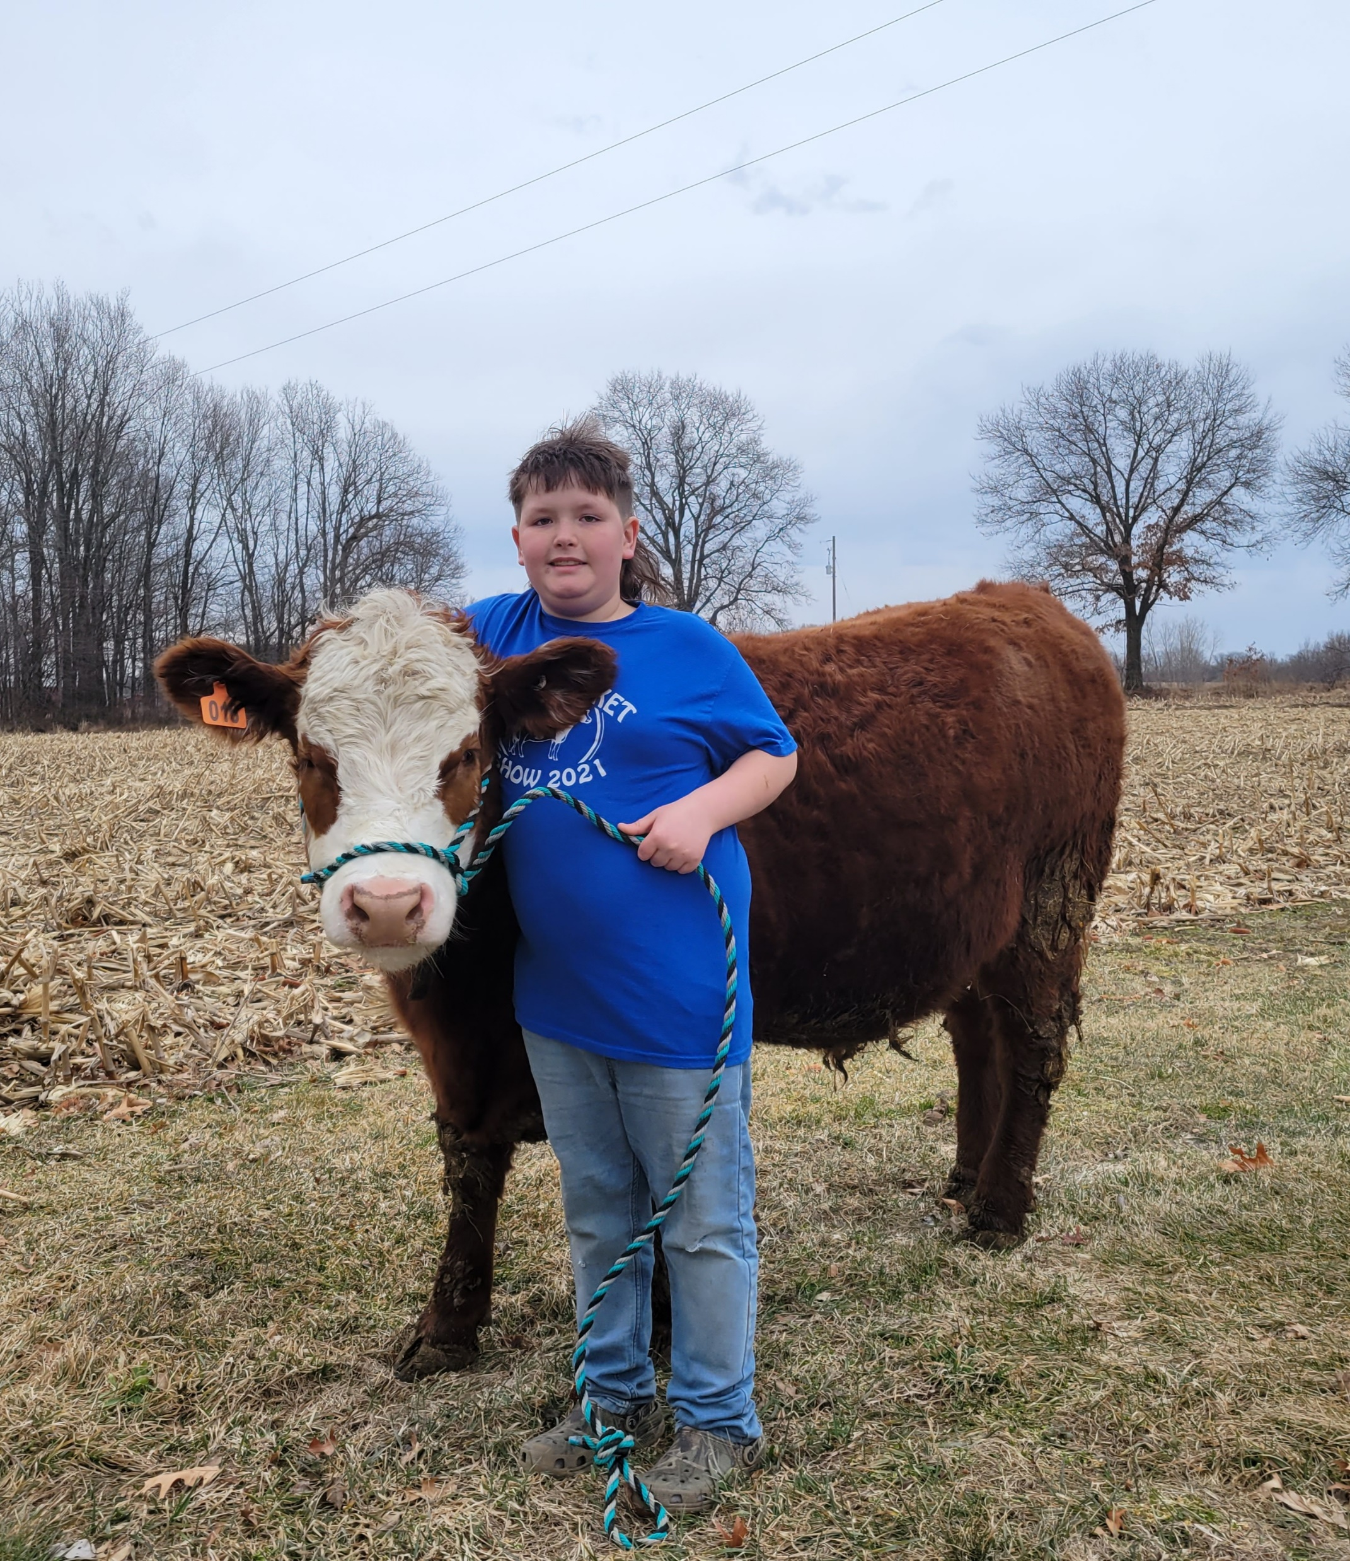
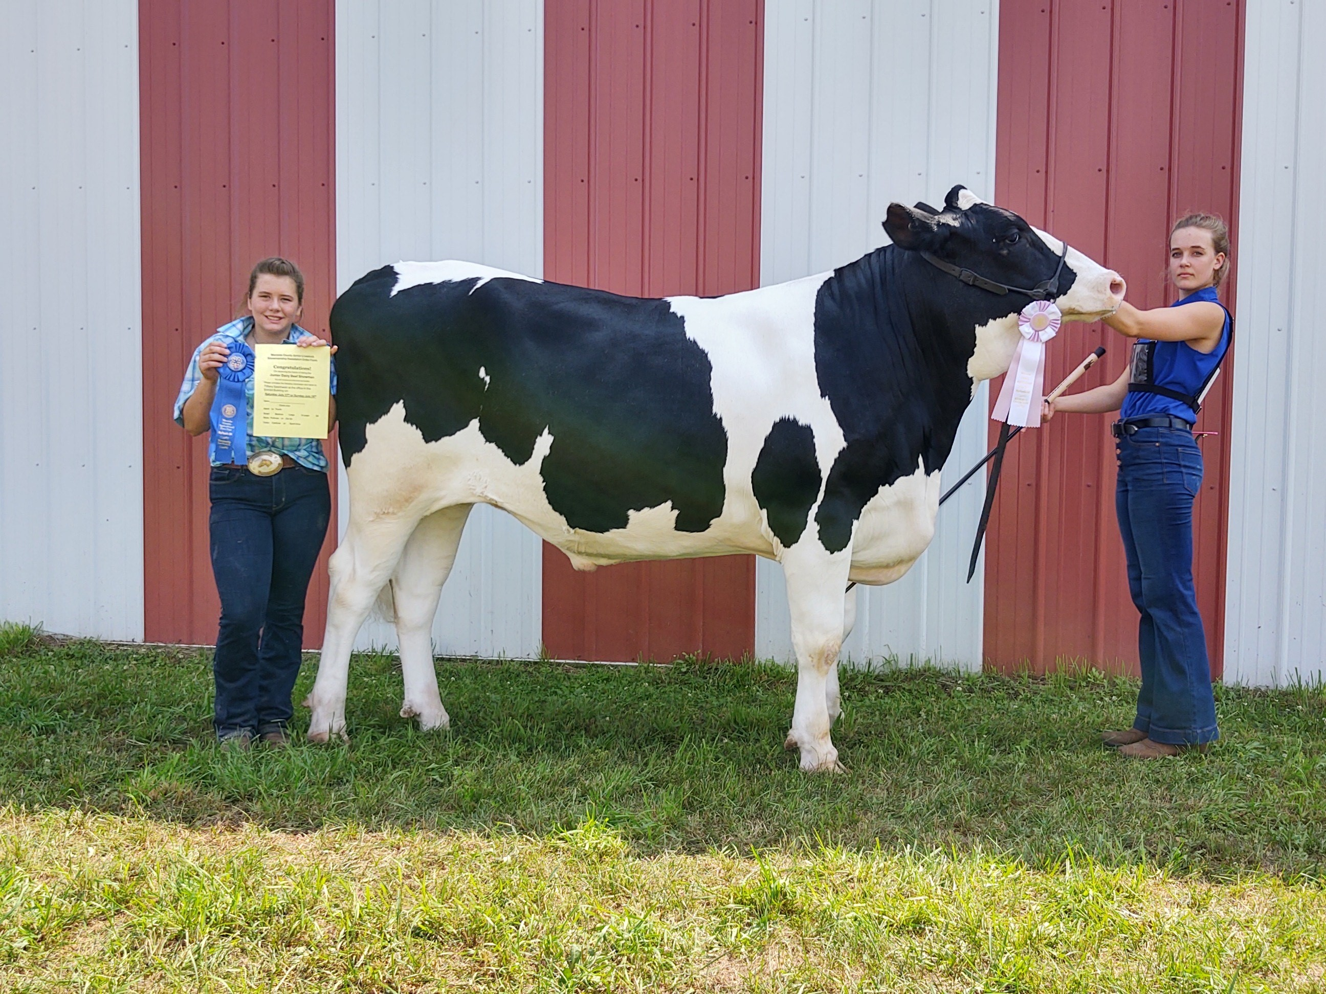


Slide 4
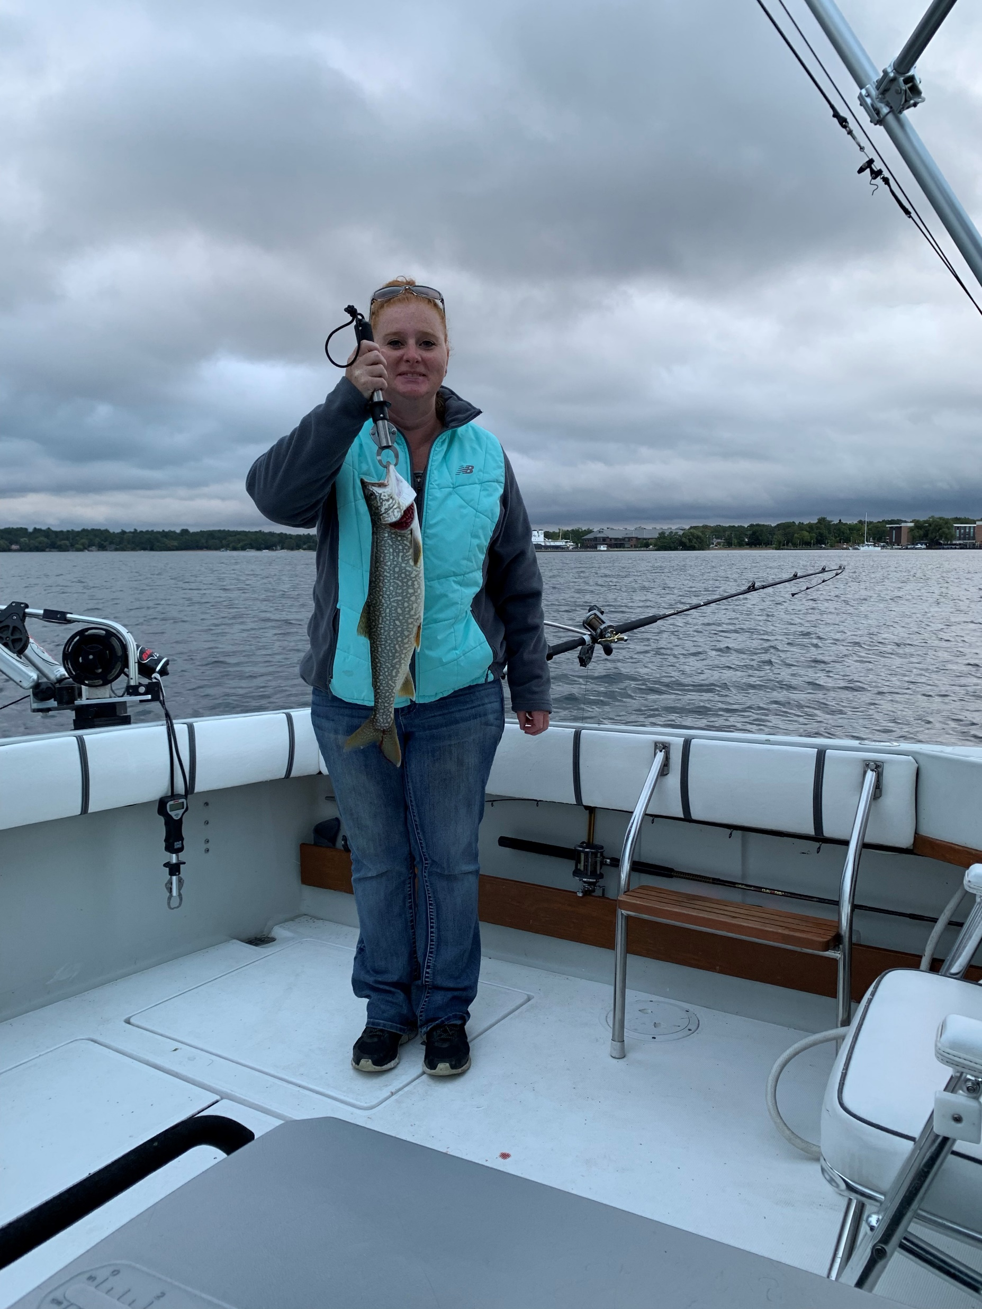
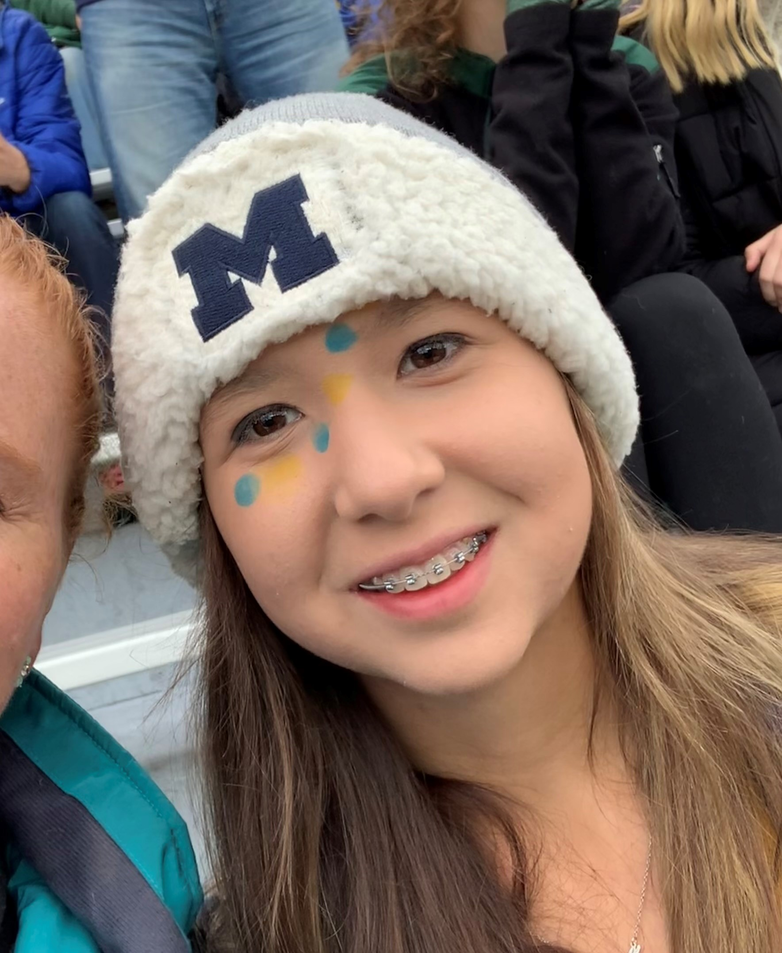
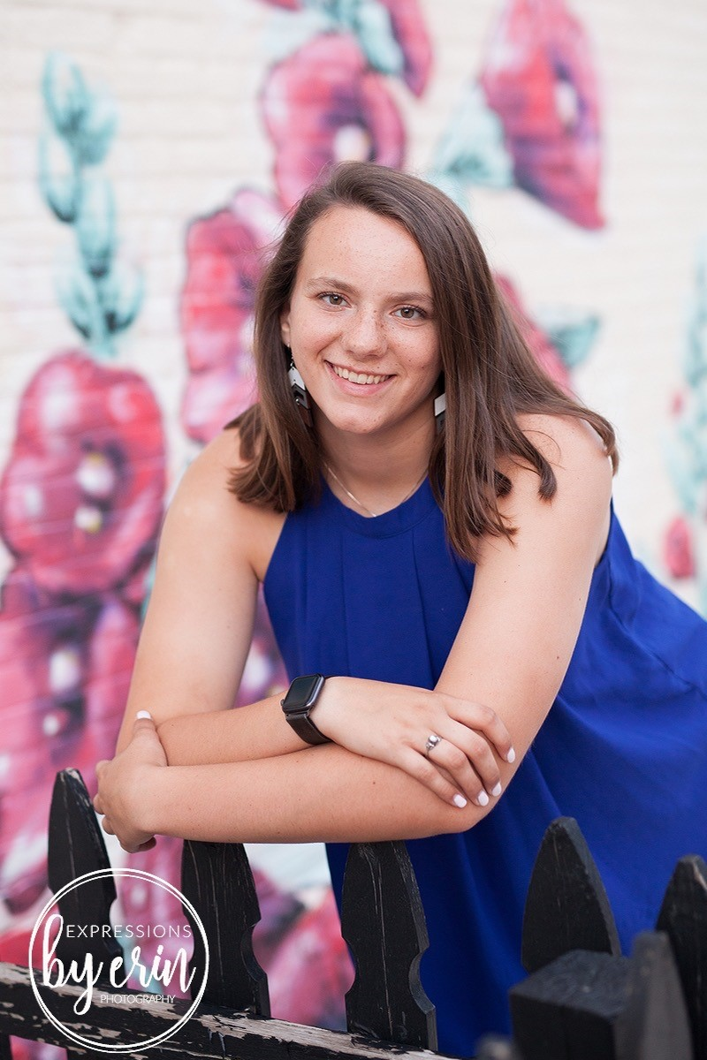
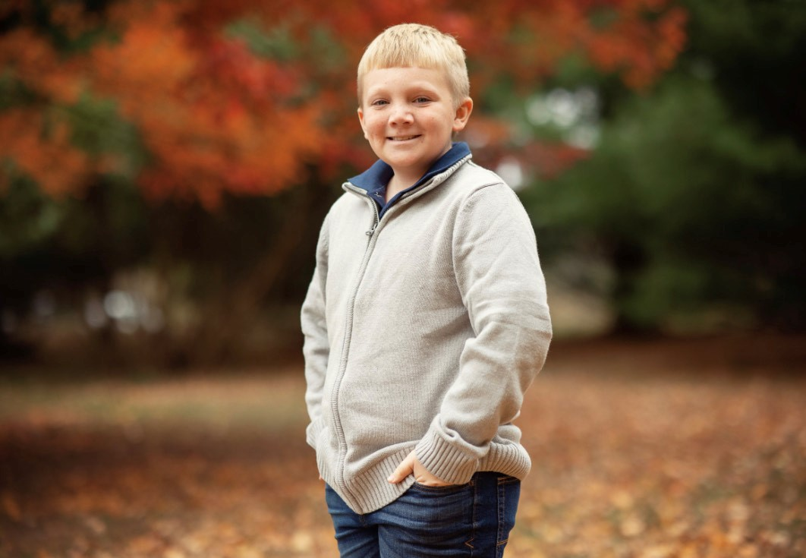


Slide 5
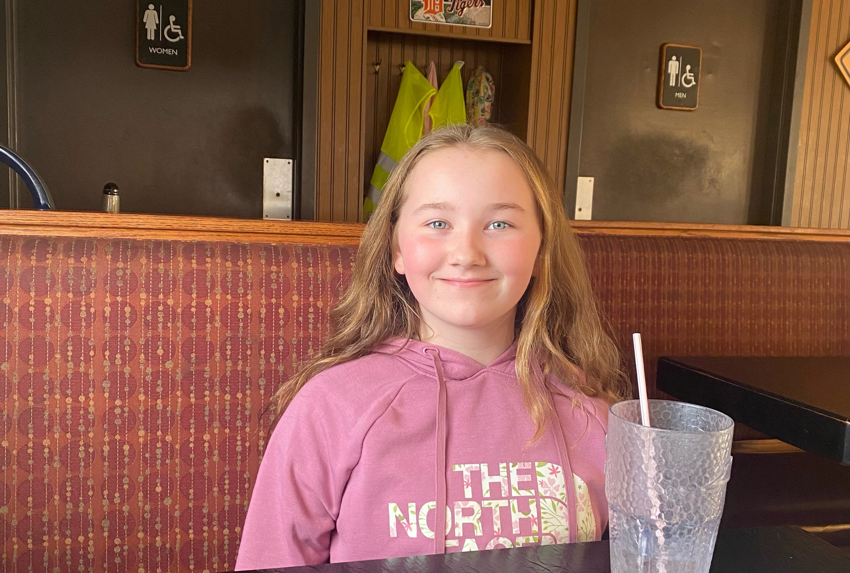
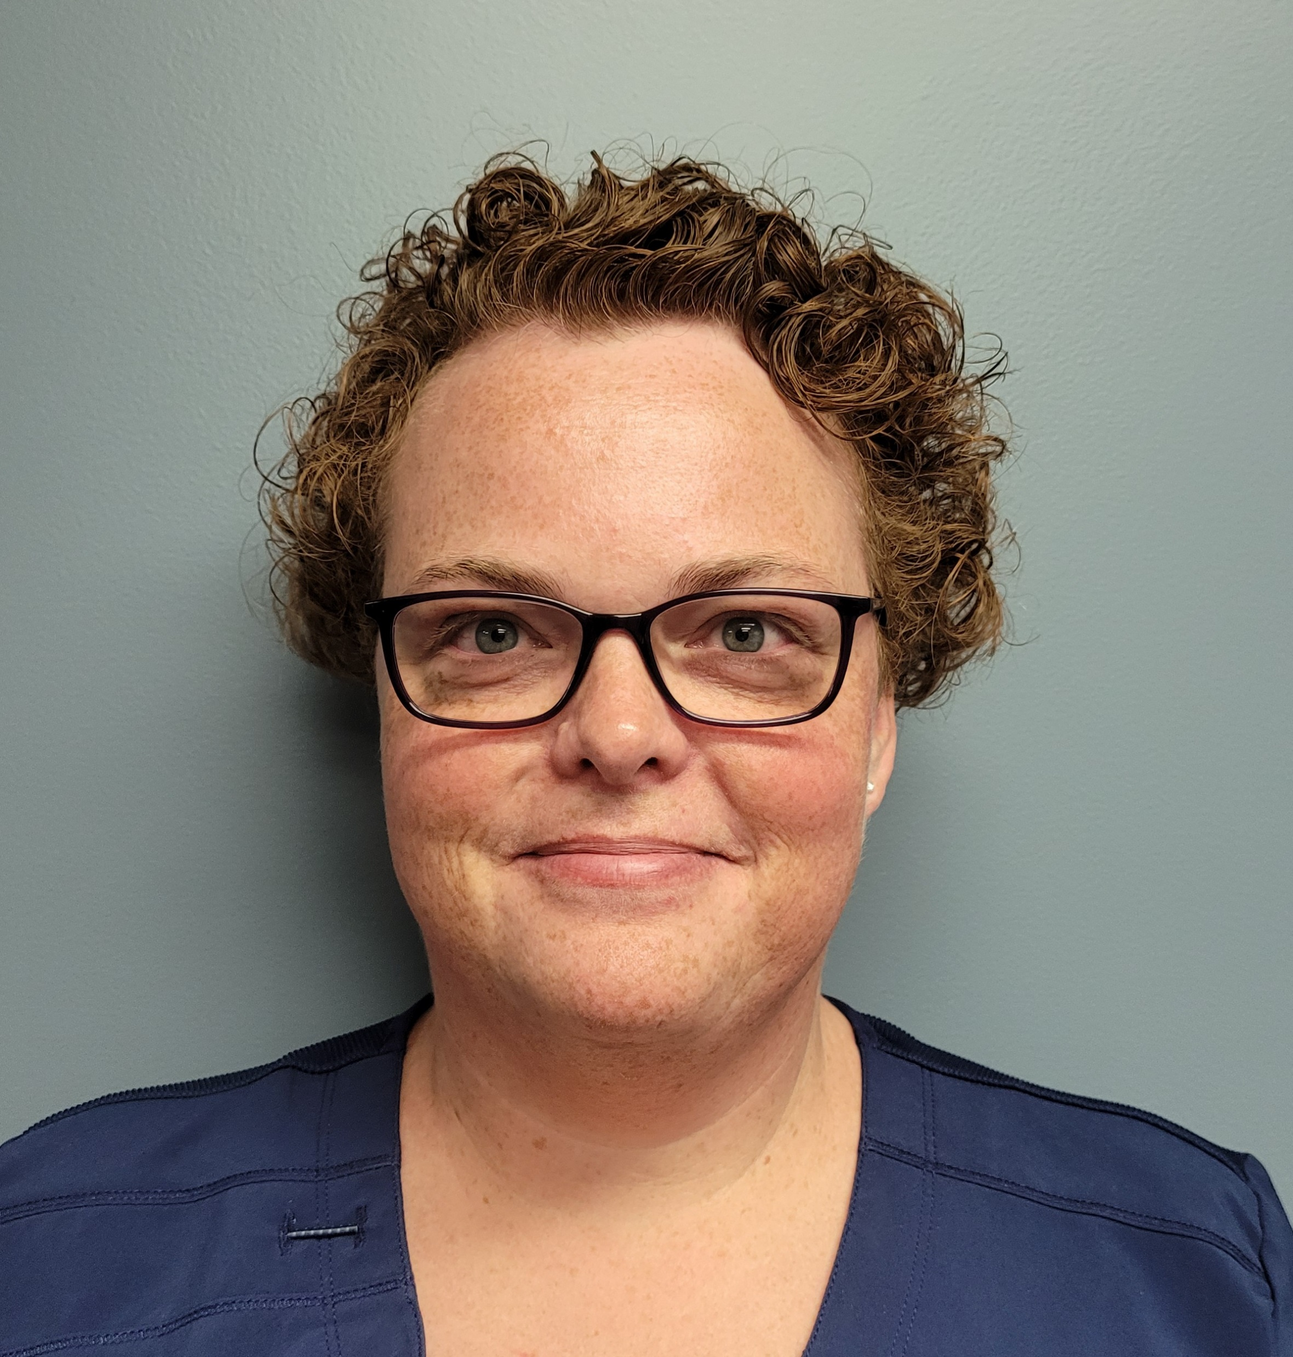
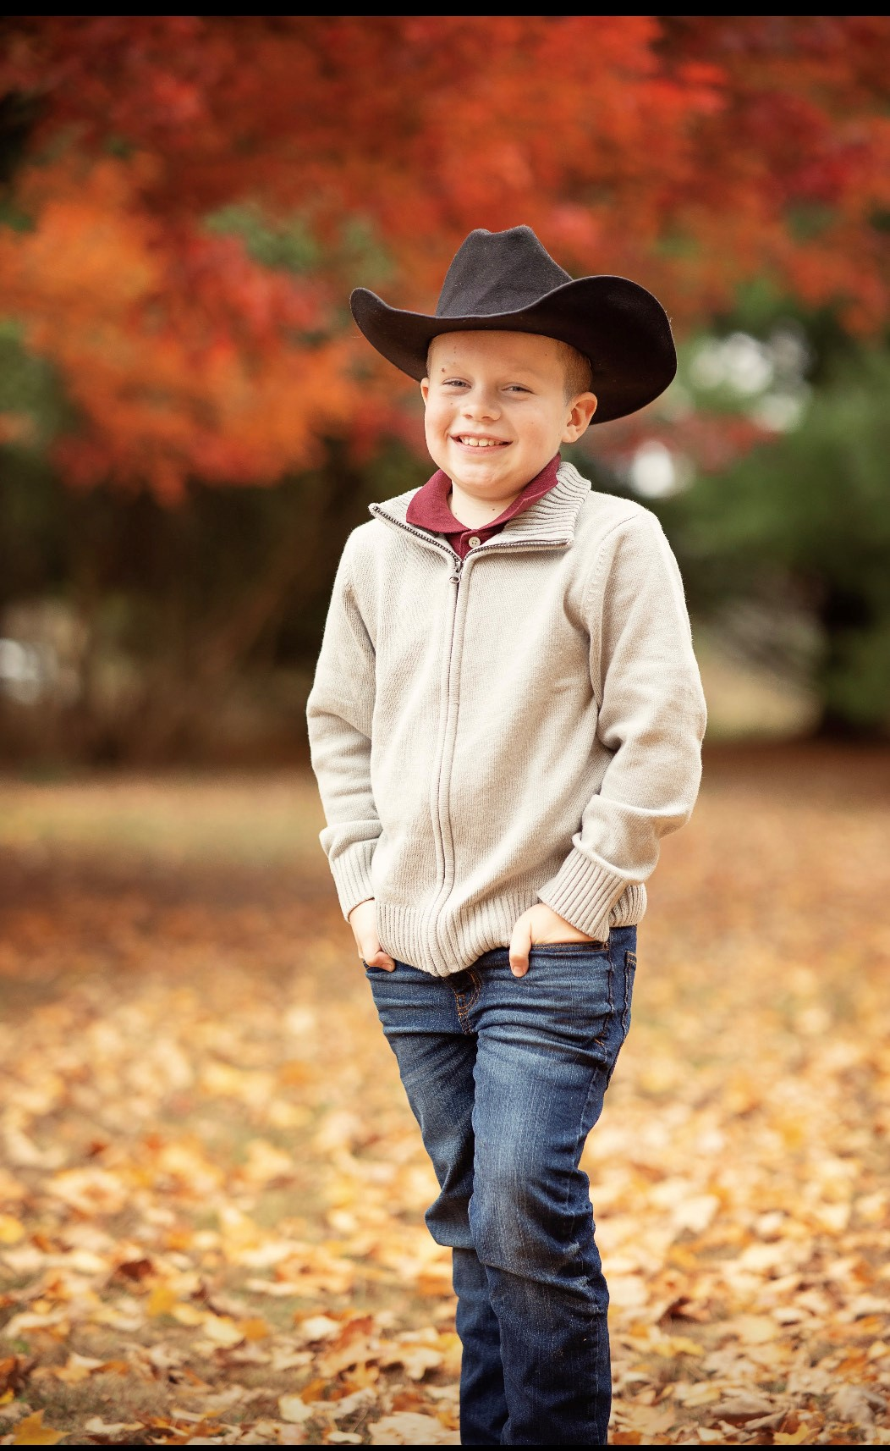

Slide 6
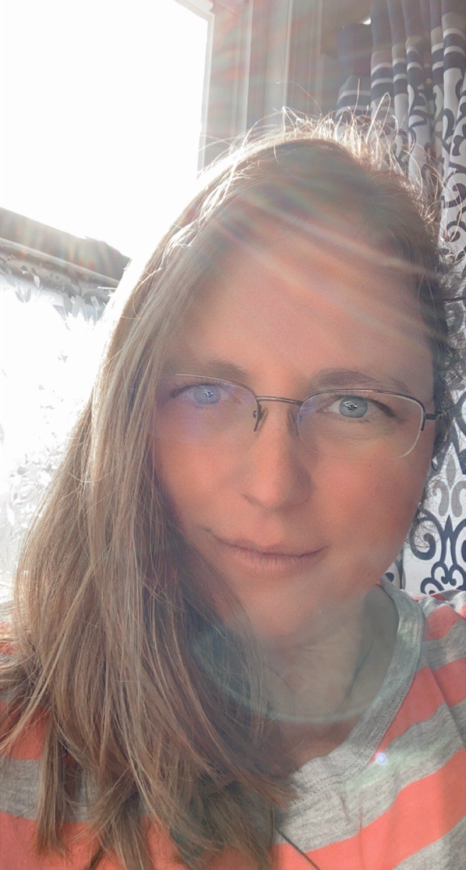
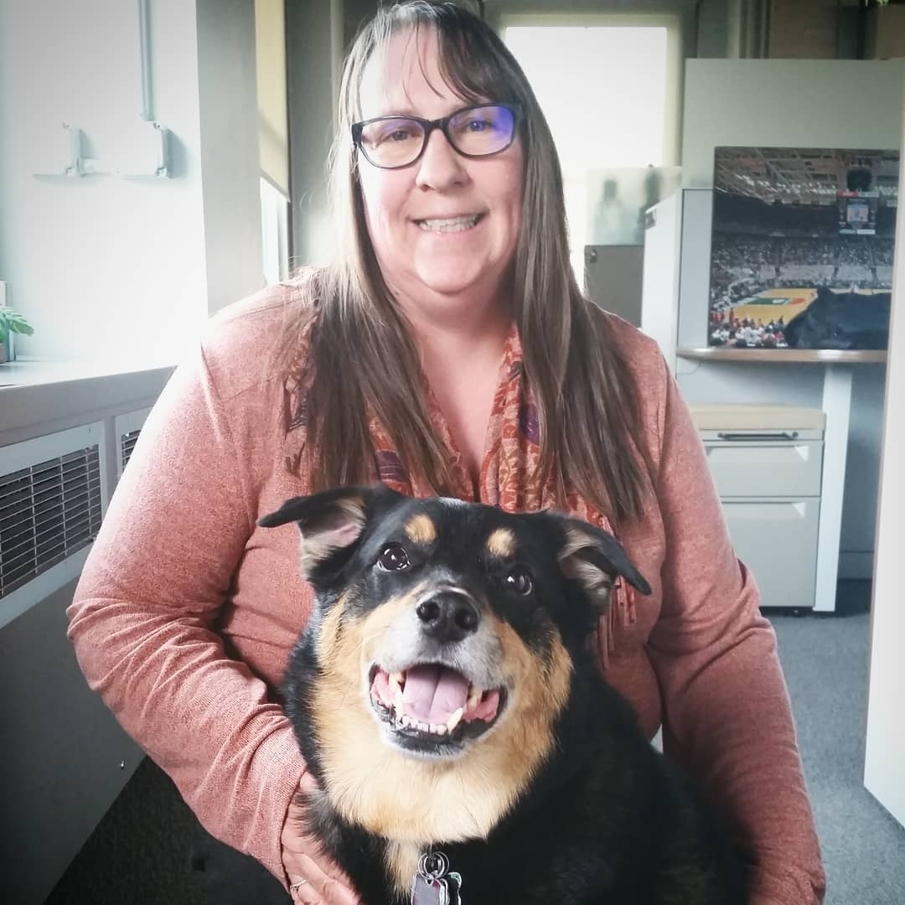
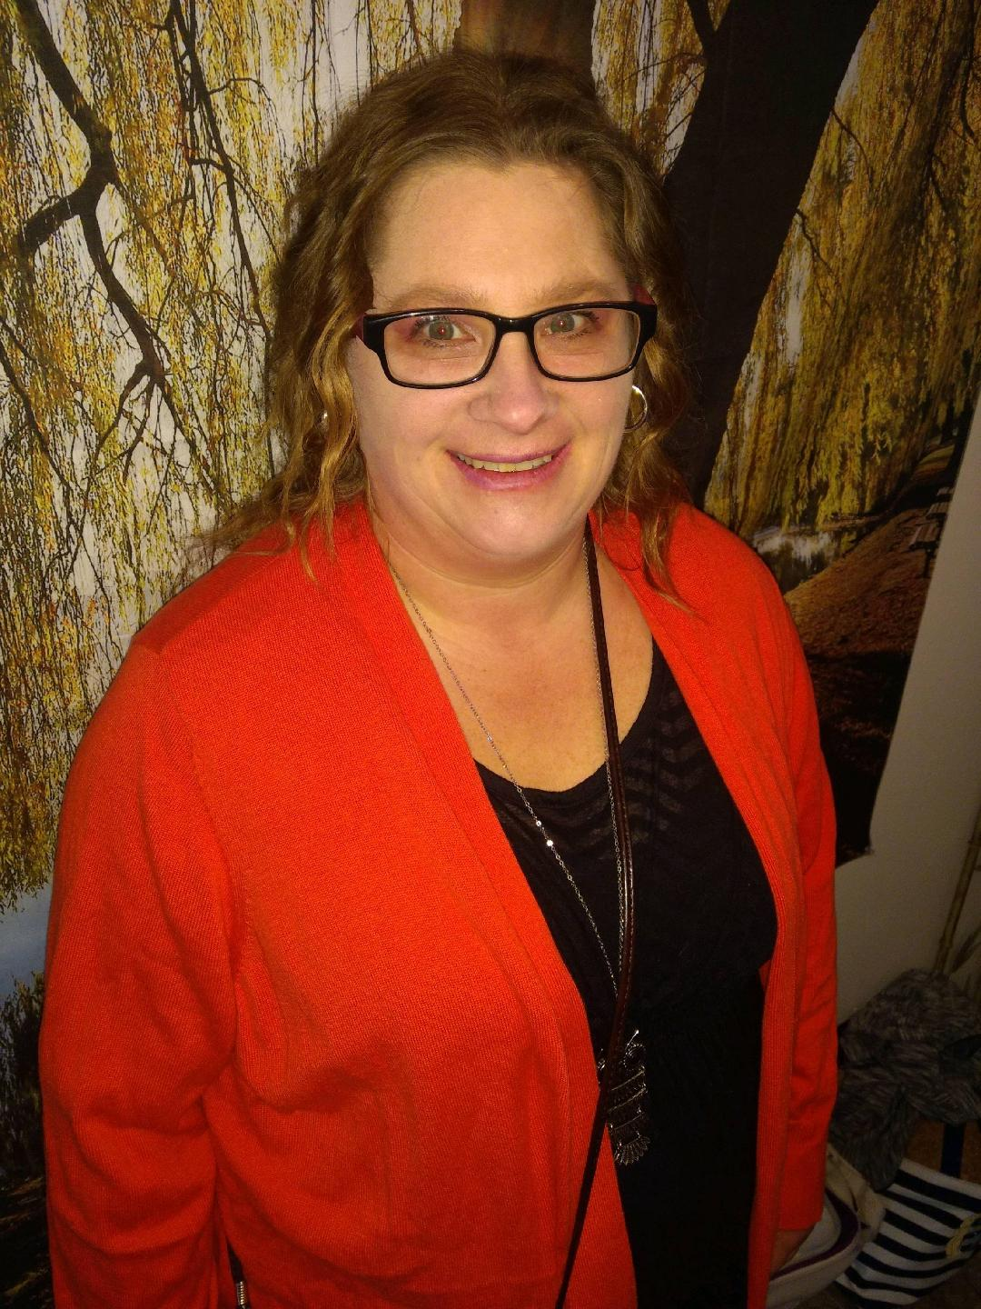

Slide 7
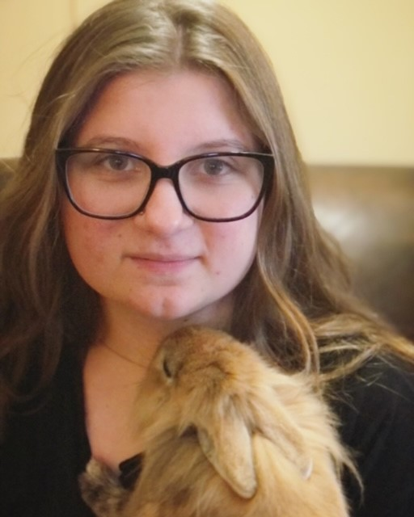
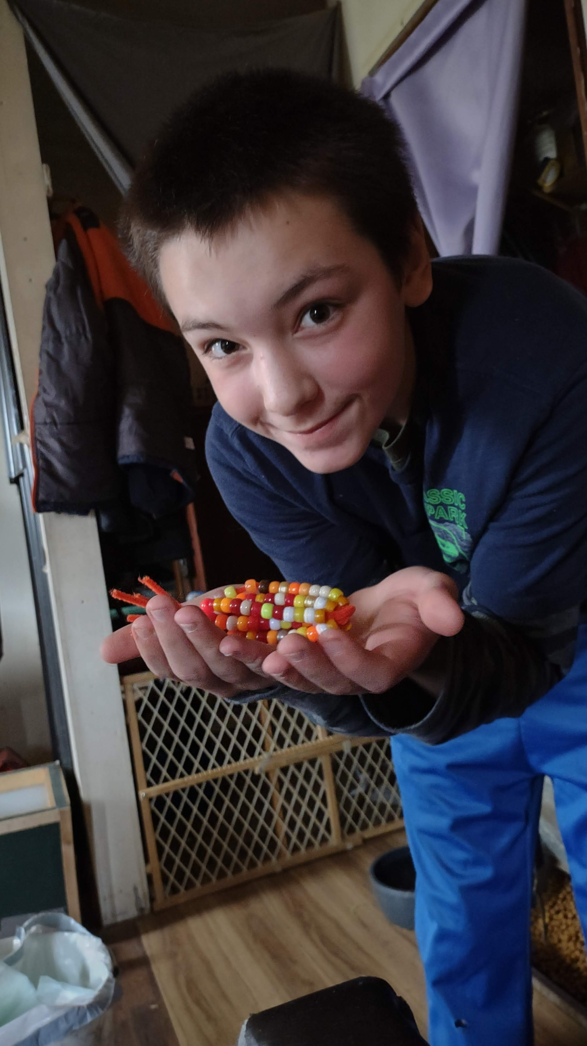
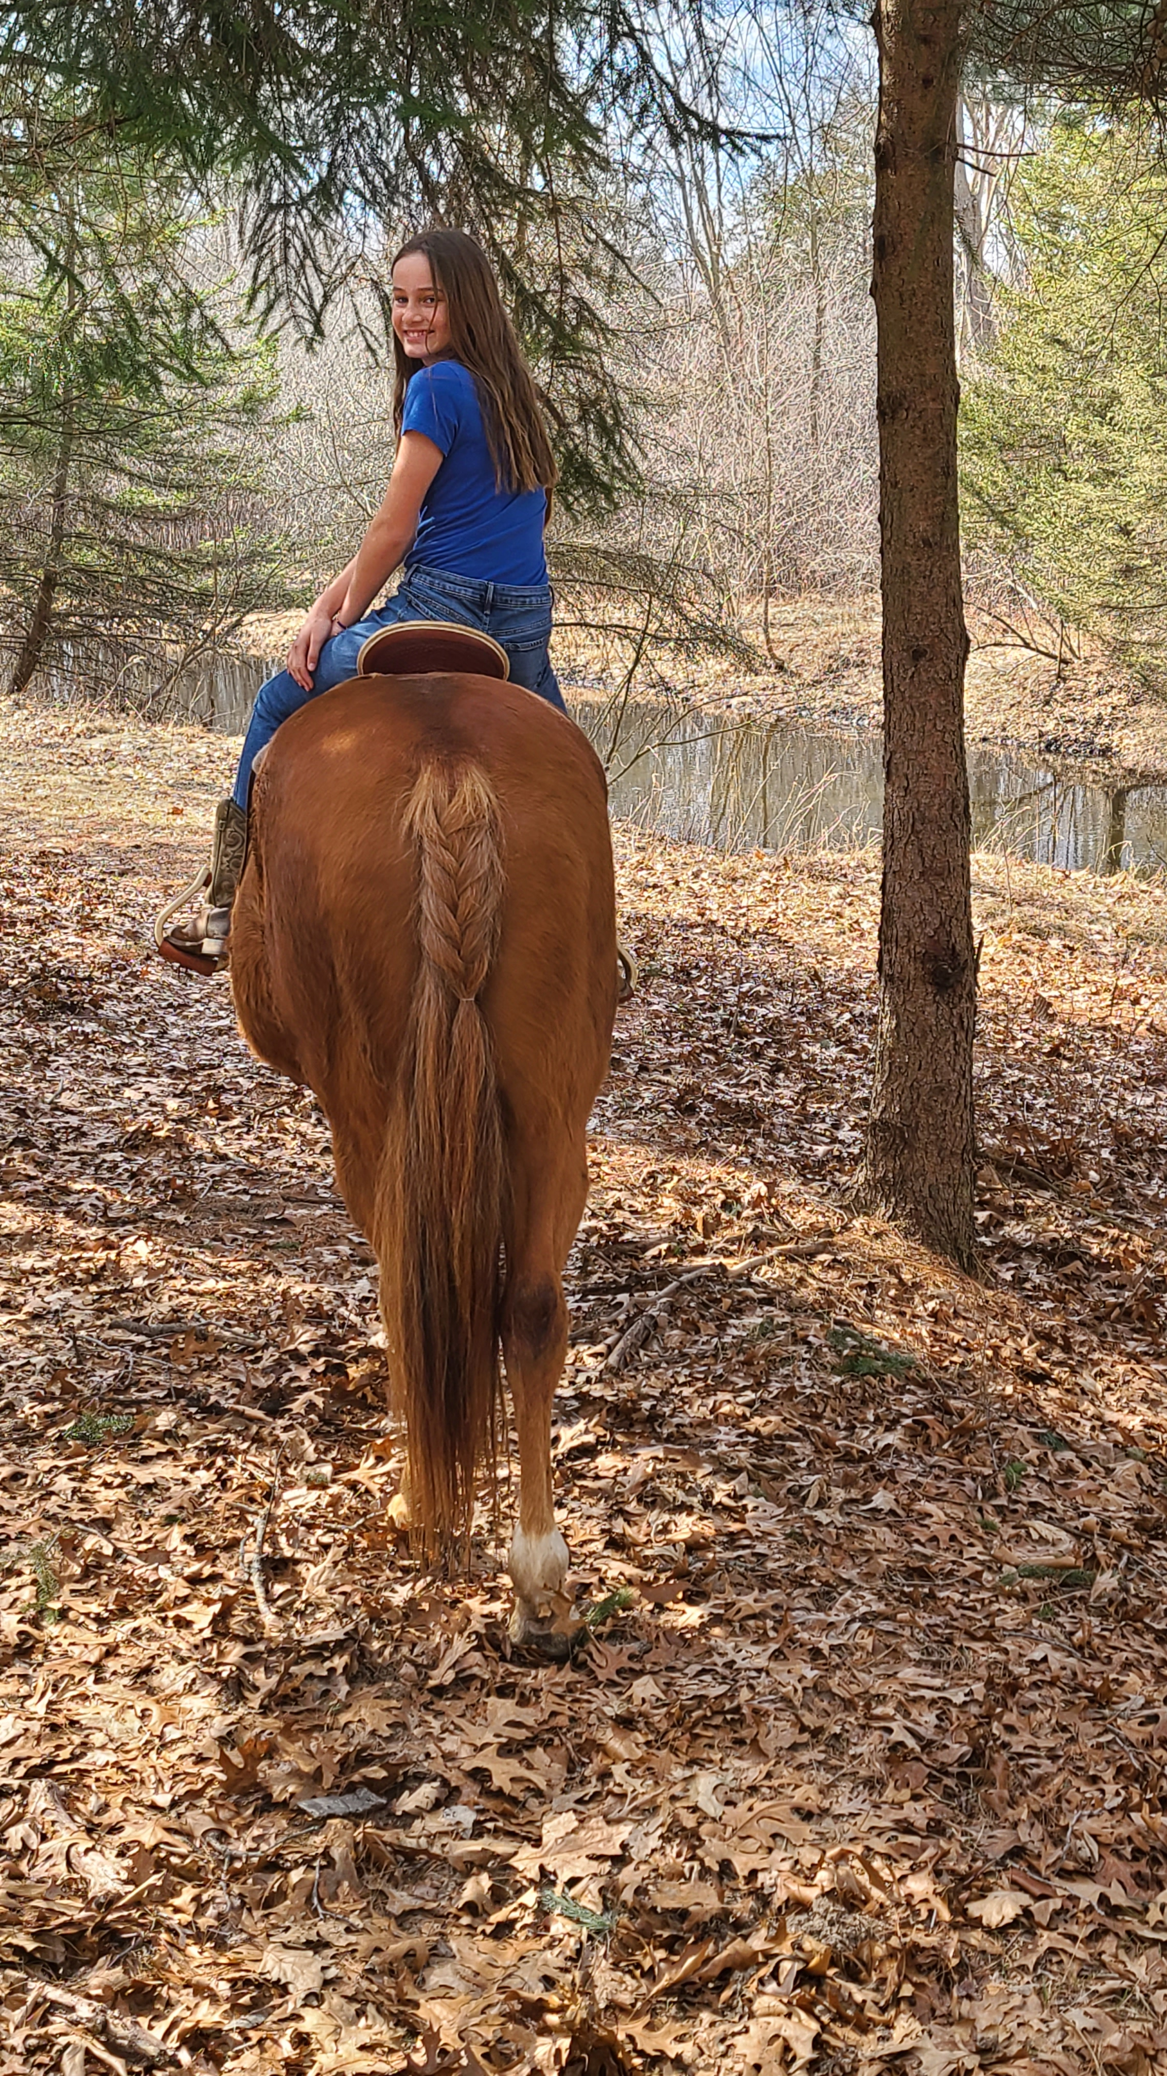

Slide 8
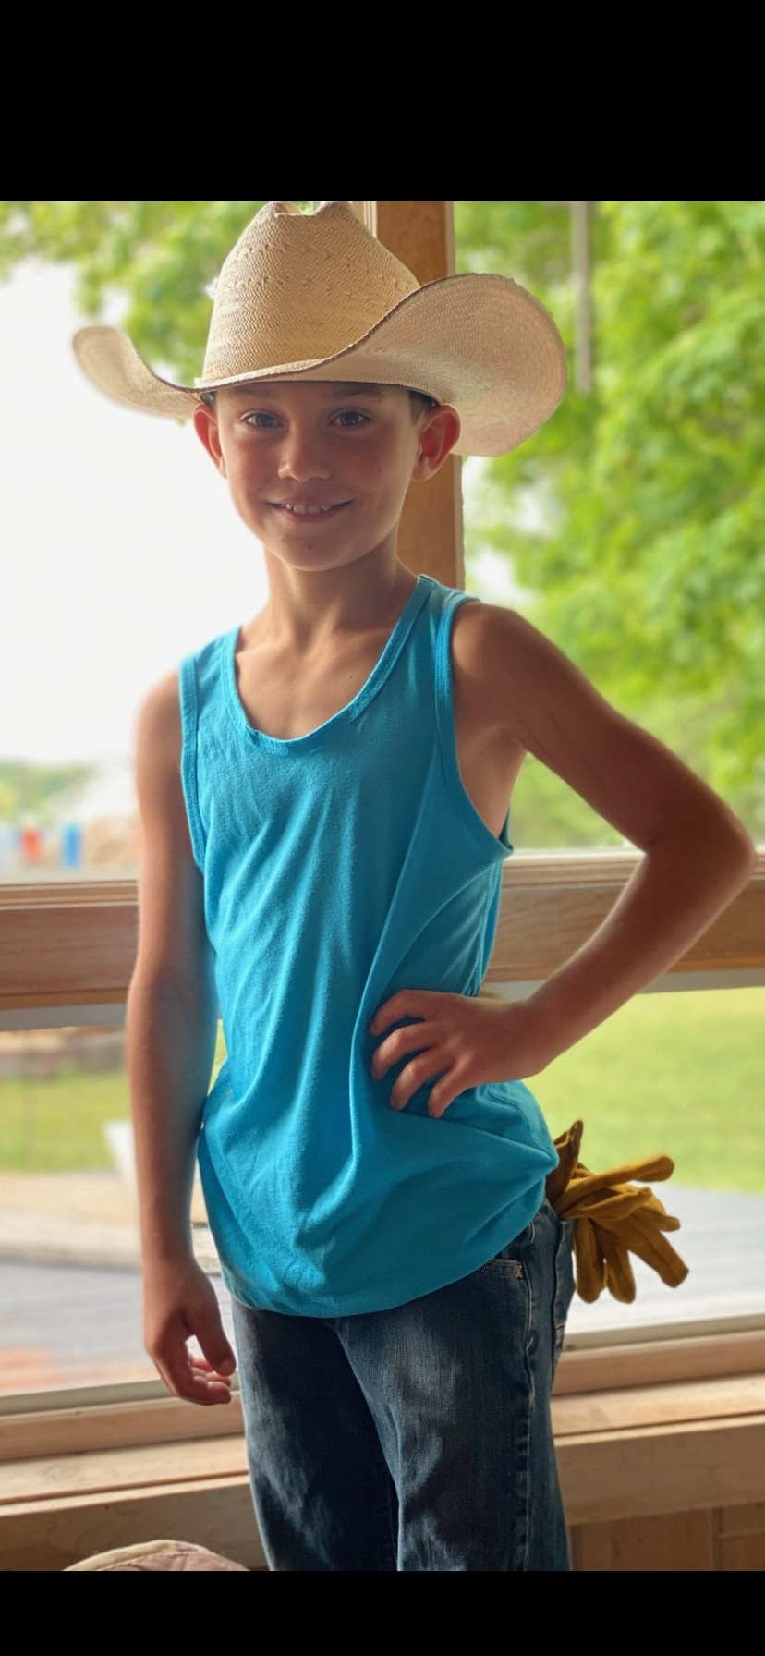
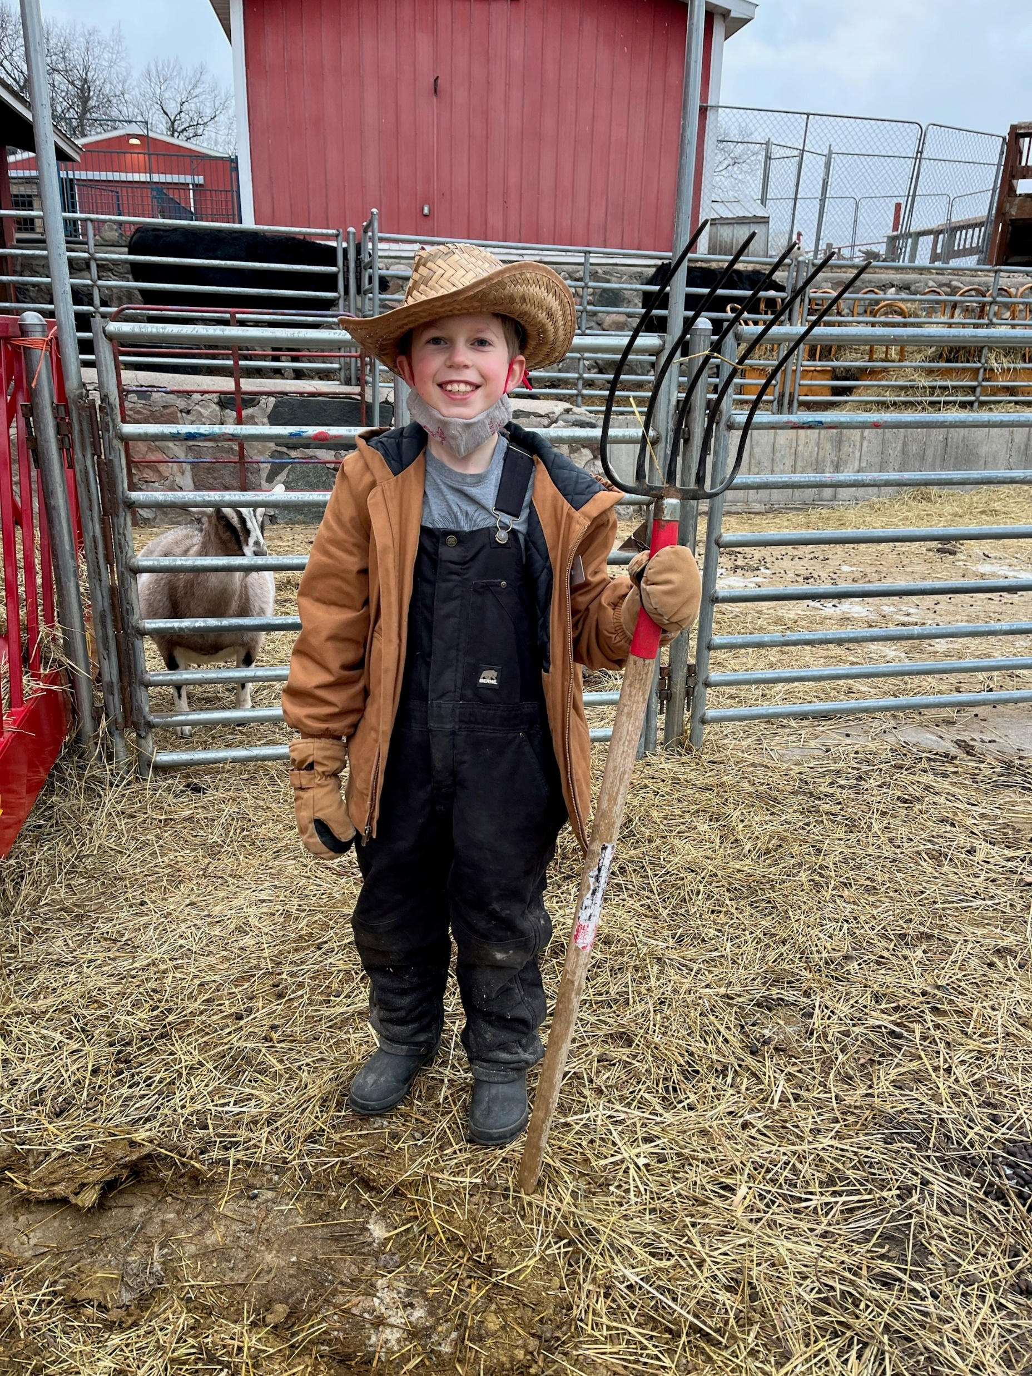
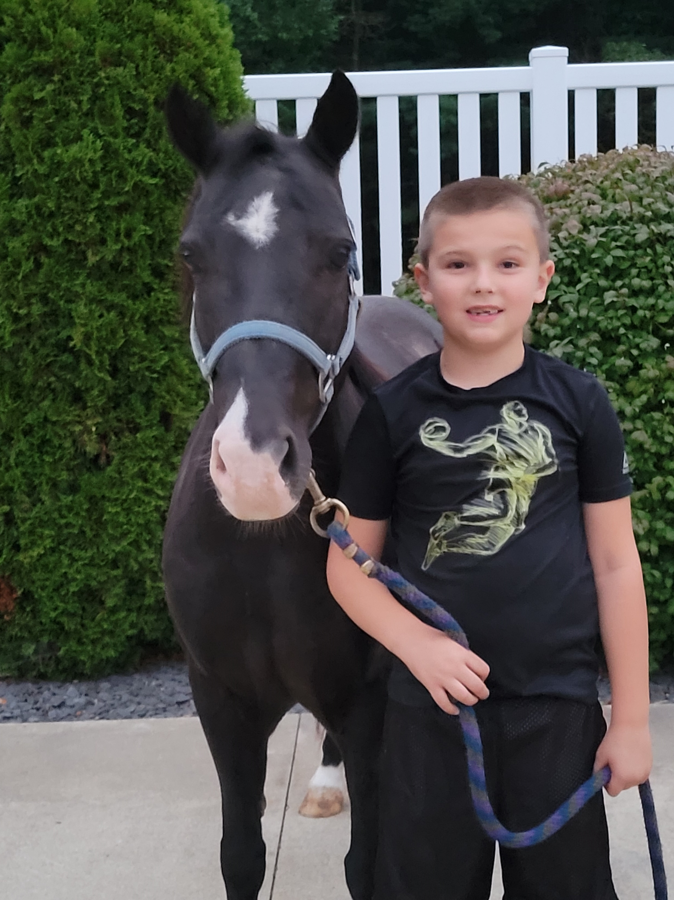
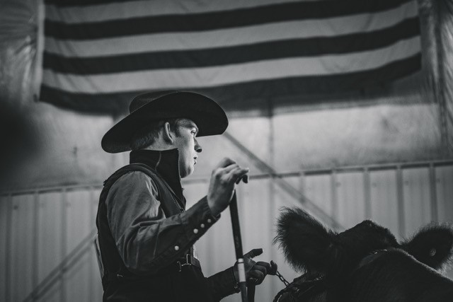

Slide 9
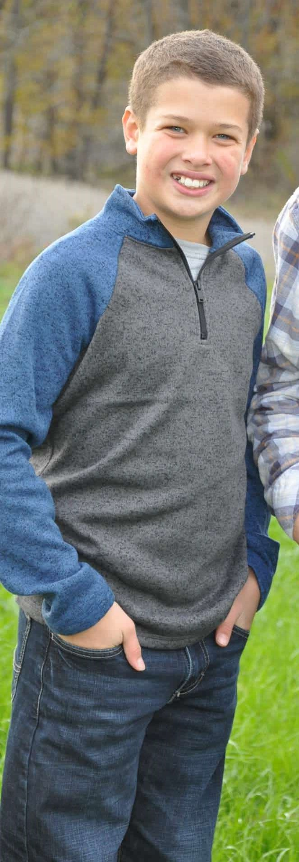
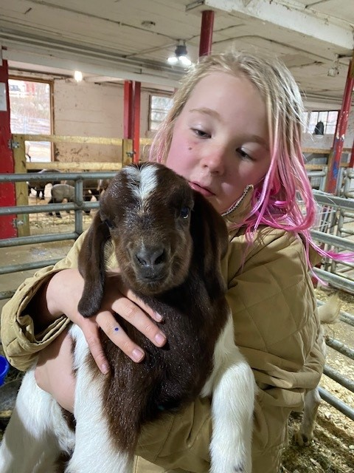
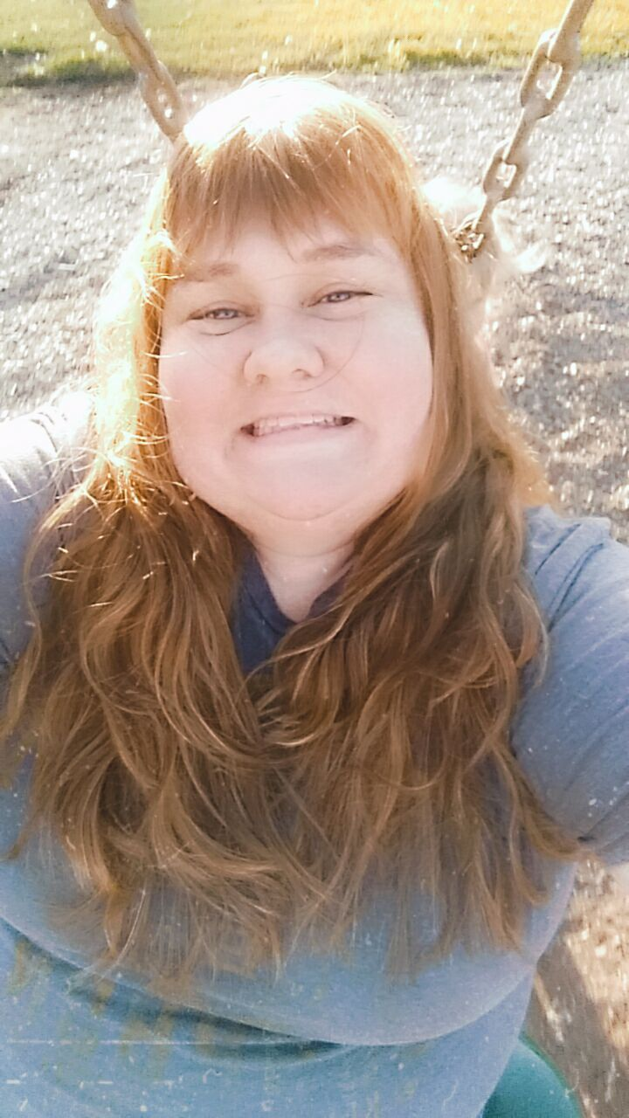

Slide 10
Adult Division
  25 Contestants
  17 State Qualifiers

Slide 11
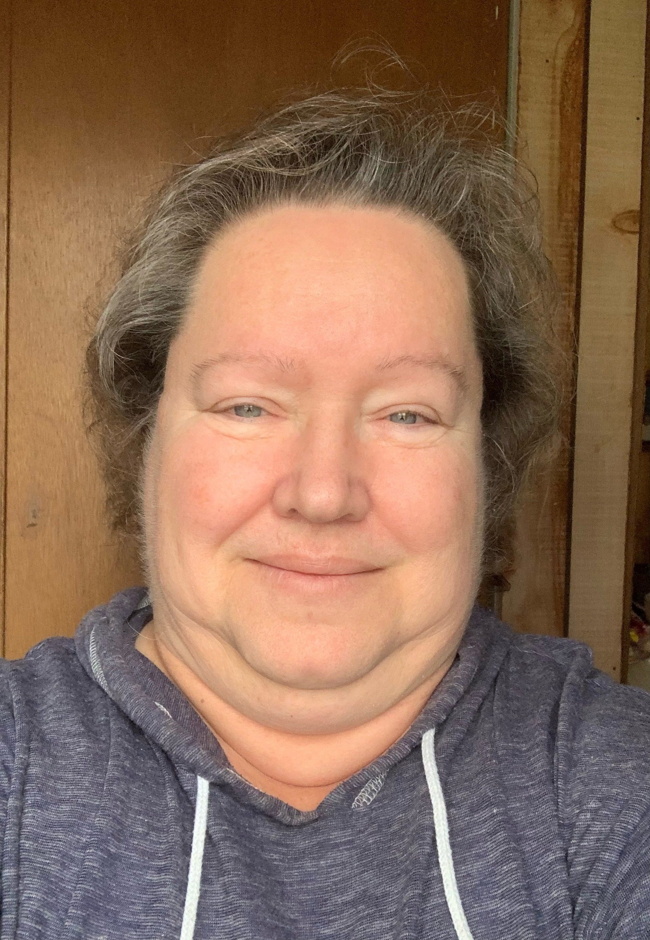
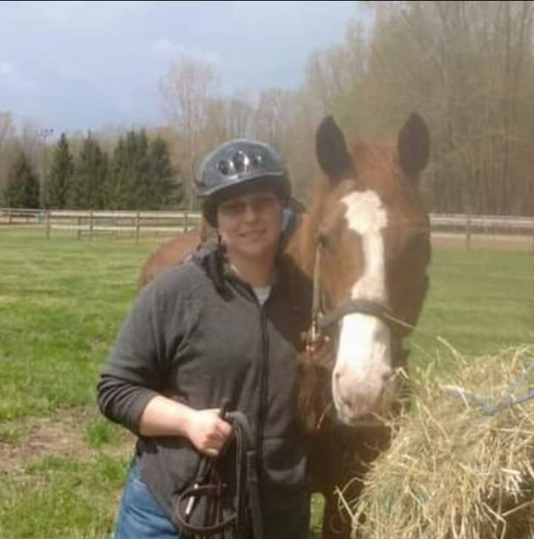
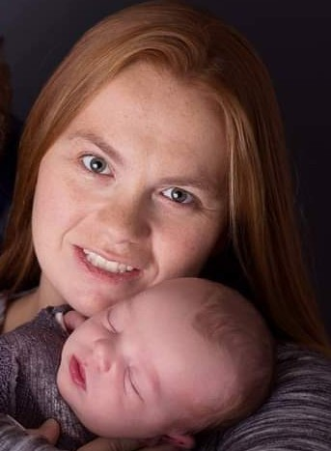
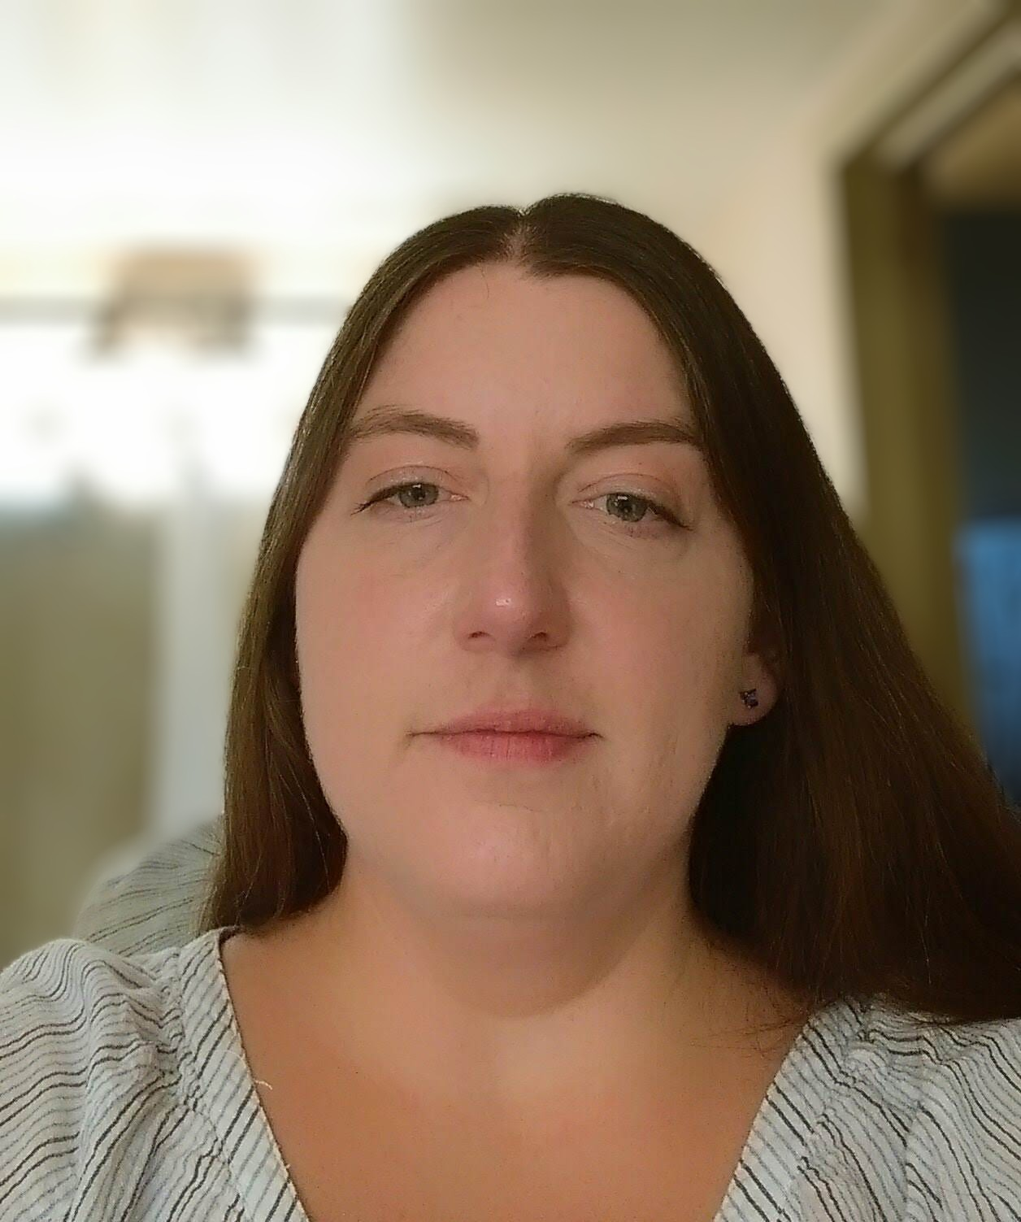
Adult Division
Katherine Pettit
Ingham
Linda “Sparky”
Willman
Wayne
Elizabeth Kotus
Monroe
Kate Parrish
Shiawassee
Not Pictured: Anne Mills
Lapeer

Slide 12

2022 Adult Champion
Kate Parrish, Shiawassee

Slide 13
Adult
Division

Slide 14
Senior Division
  Ages 15 – 19
  60 Contestants
  20 State Qualifiers

Slide 15
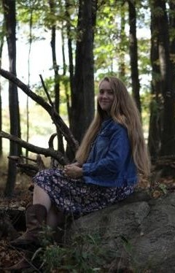
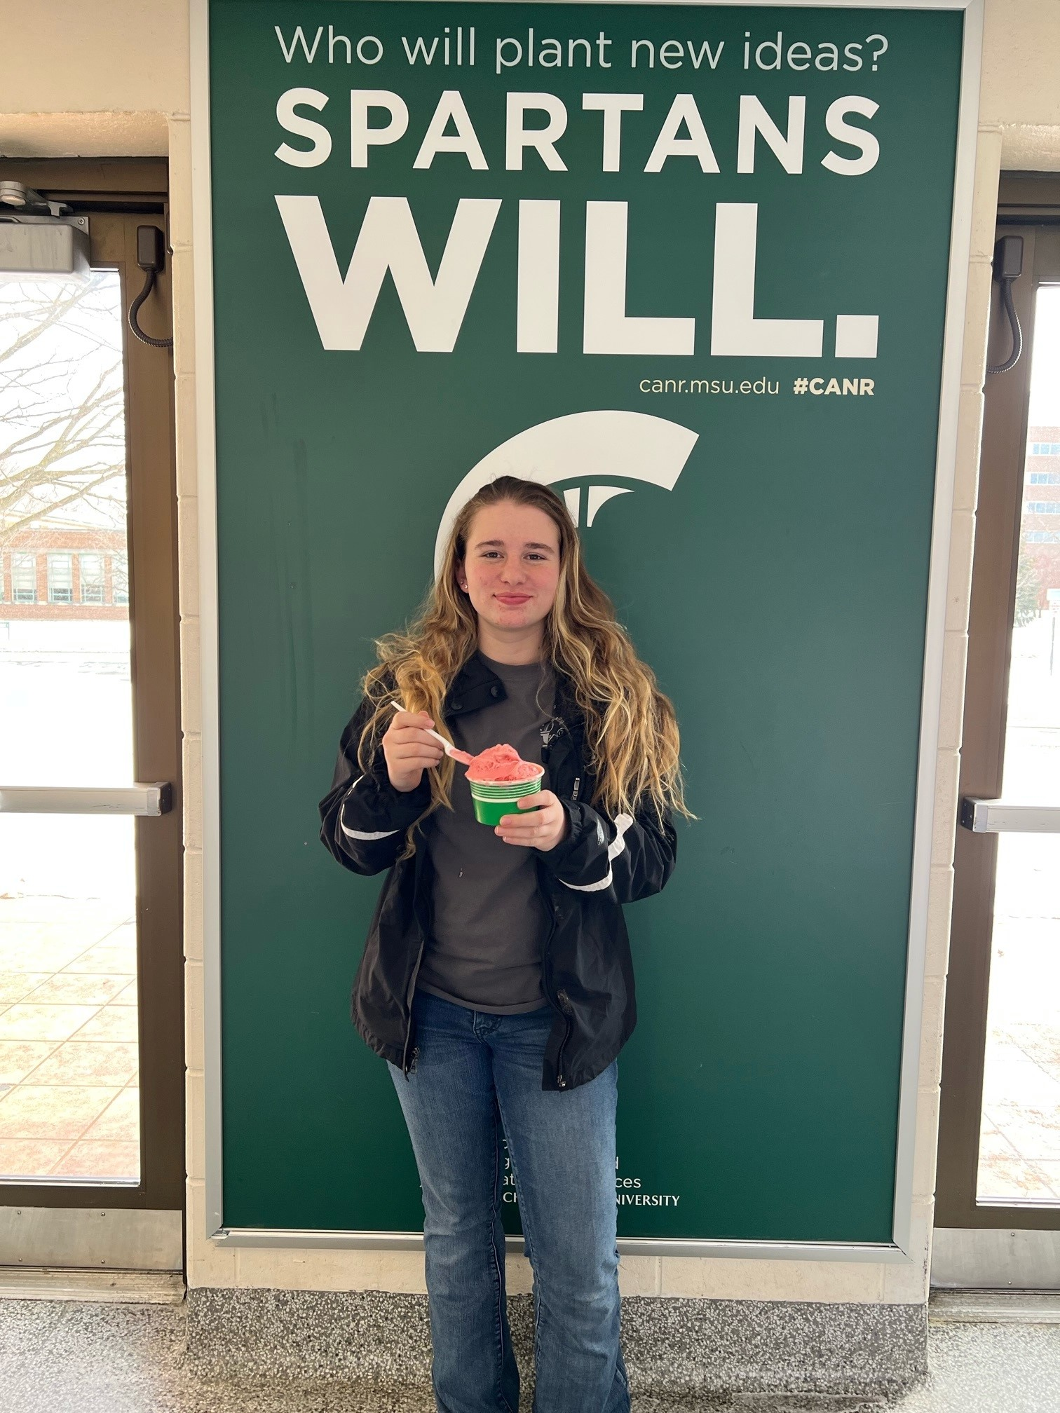
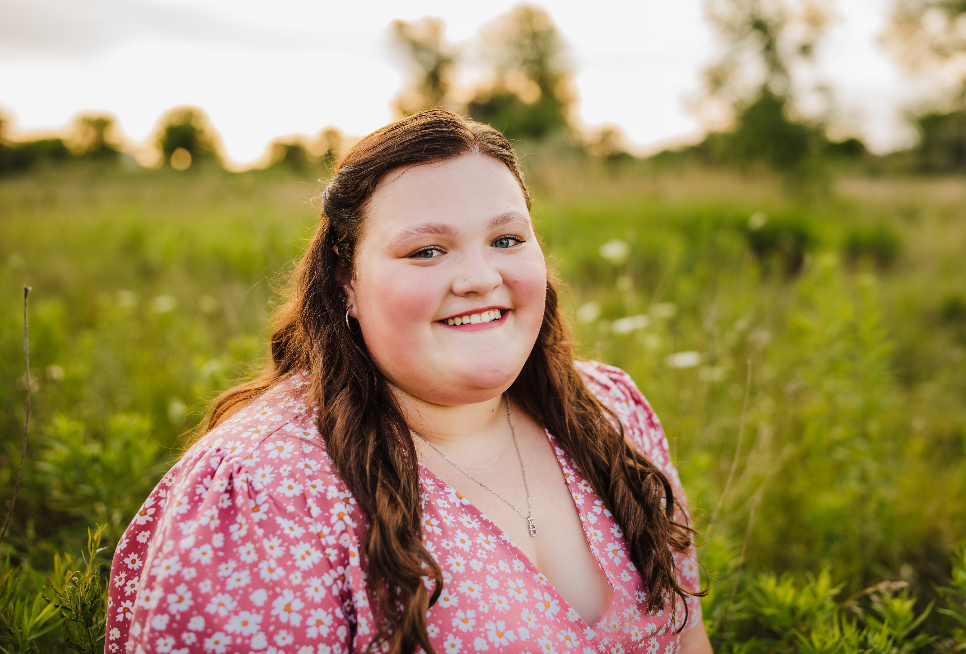
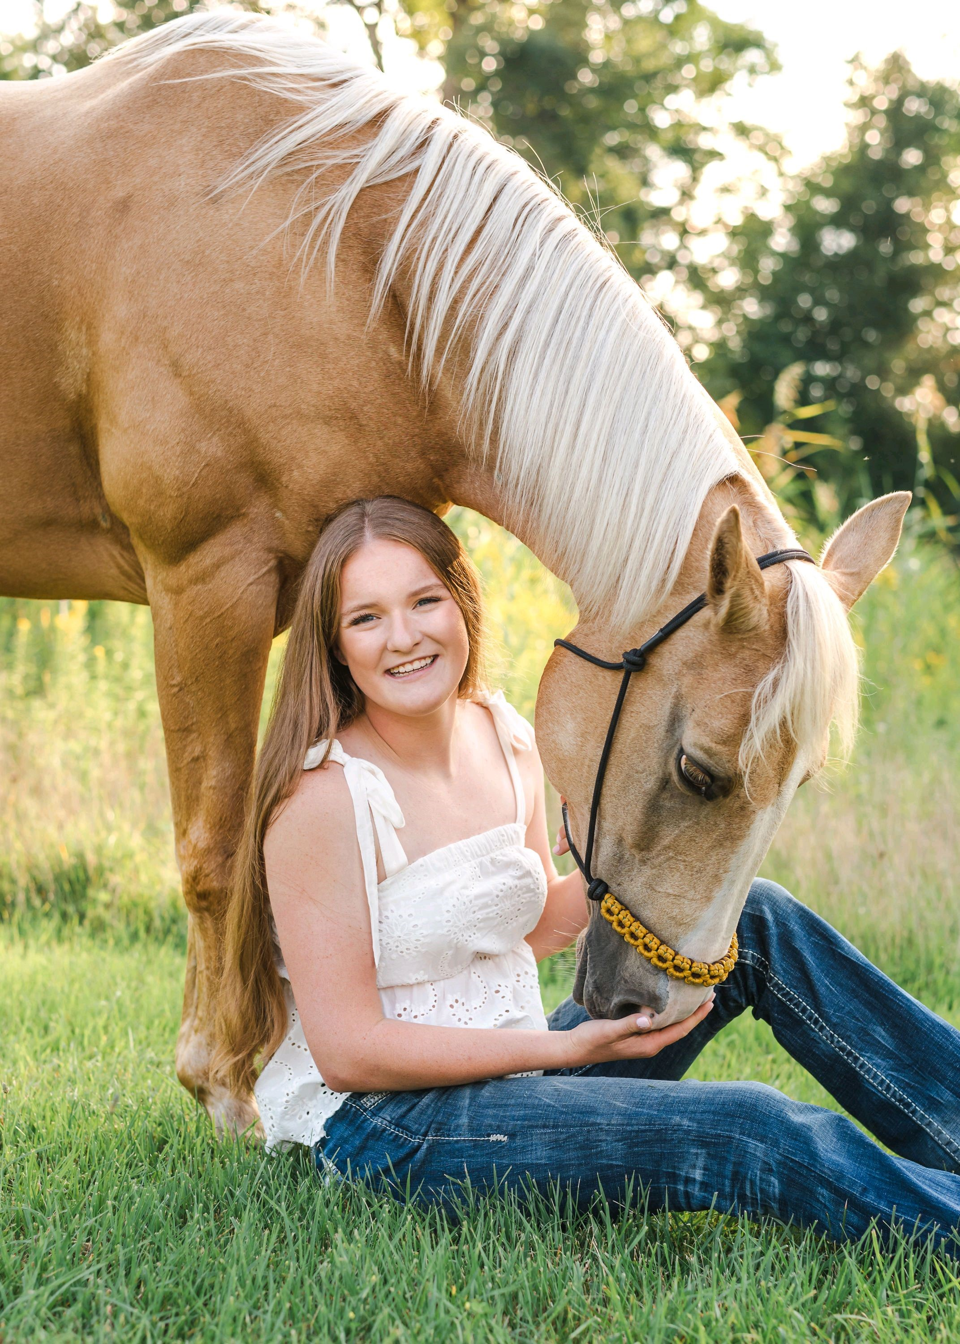
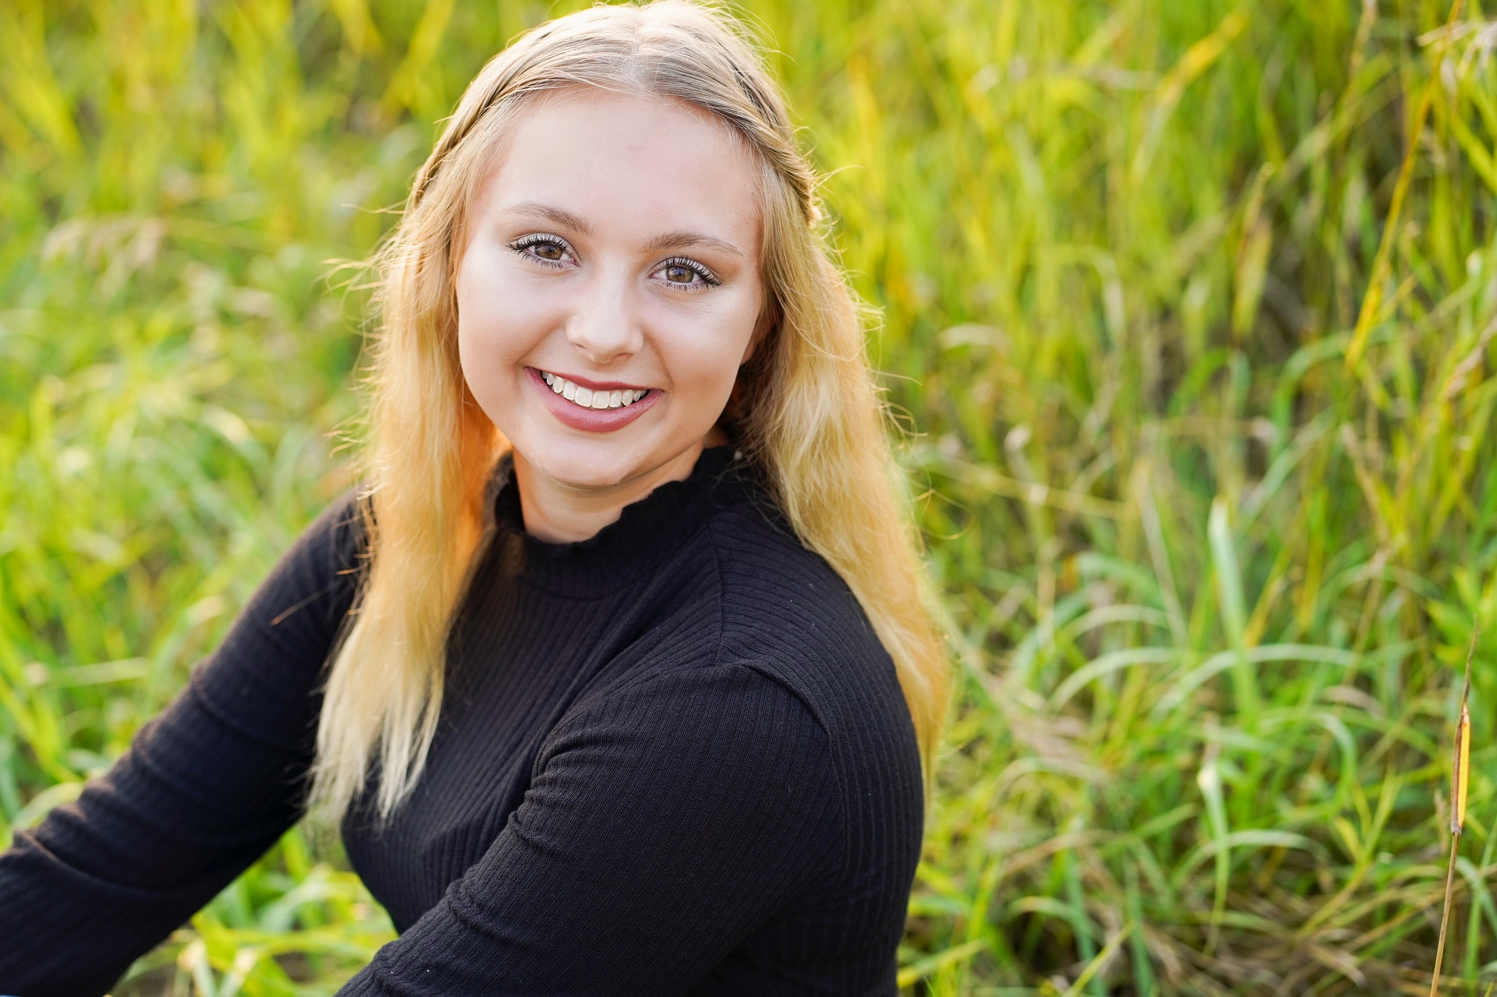
Senior Division
Brenna Marshall
Ingham
Caitlynn Pratt
Otsego
Hunter Ballor
Alpena
Cassidy Cashen
Ionia
Elizabeth Underhill
Mecosta

Slide 16
2022 Senior Champion
Caitlynn Pratt, Otsego

Slide 17
Senior
Division

Slide 18
Junior Division
  31 Contestants
  11 State Qualifiers

Slide 19
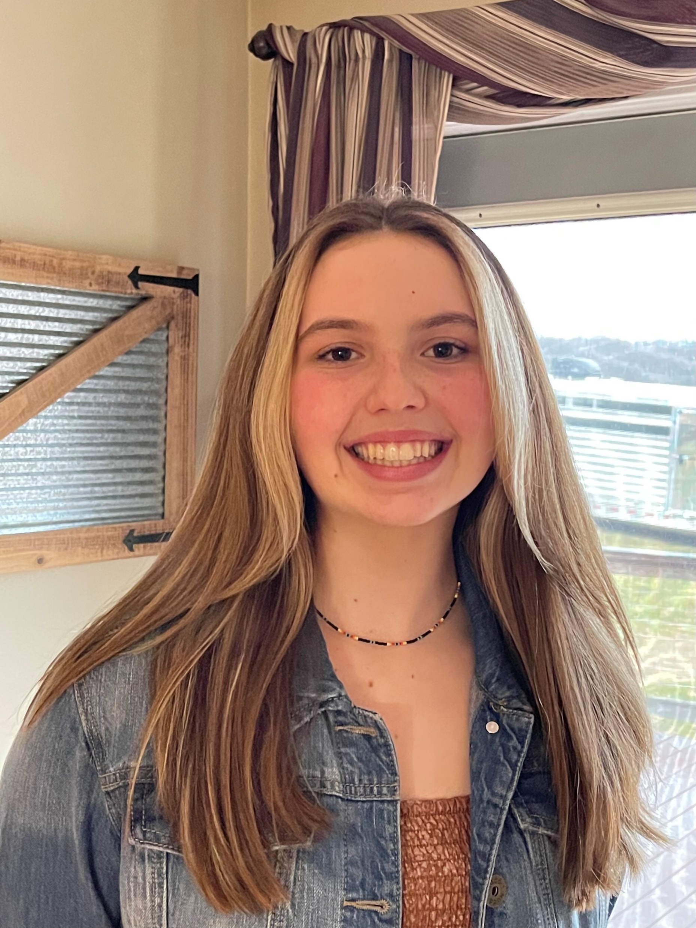
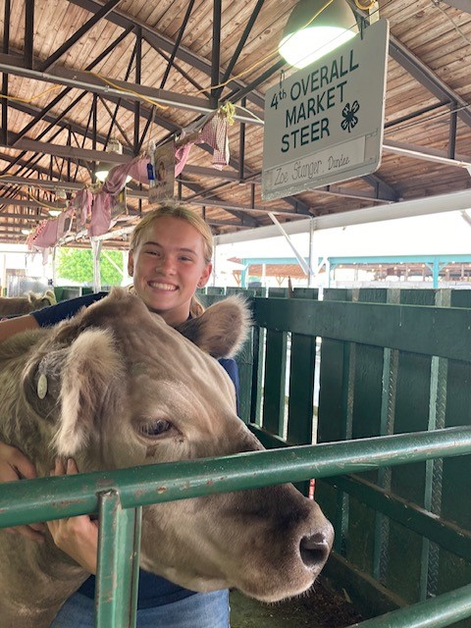
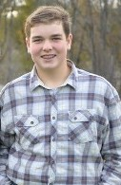
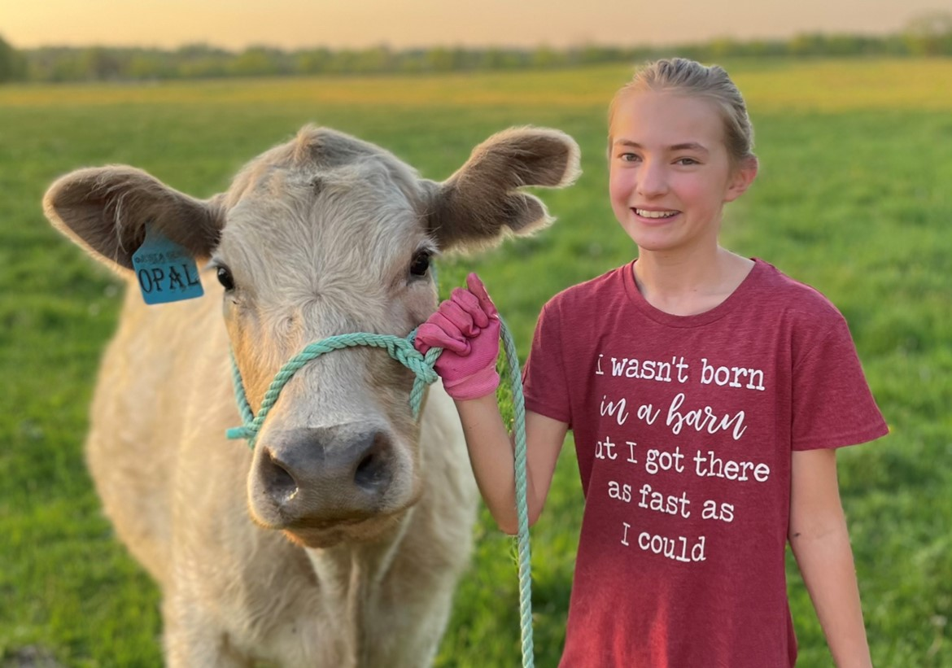
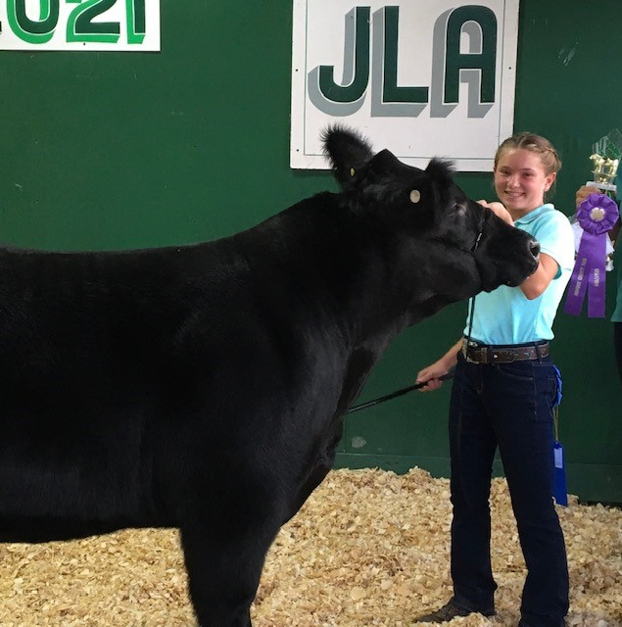
Junior Division
Jayden Herzog
Mecosta
Sophie Stanger
Monroe
Zoe Stanger
Monroe
Carson Garrison
Lenawee
Jaylee Somero
Gogebic

Slide 20
2021 & 2022 Junior Champion
Jaylee Somero, Gogebic

Slide 21
Junior
Division

Slide 22
Novice Division
  29 Contestants
  15 State Qualifiers

Slide 23
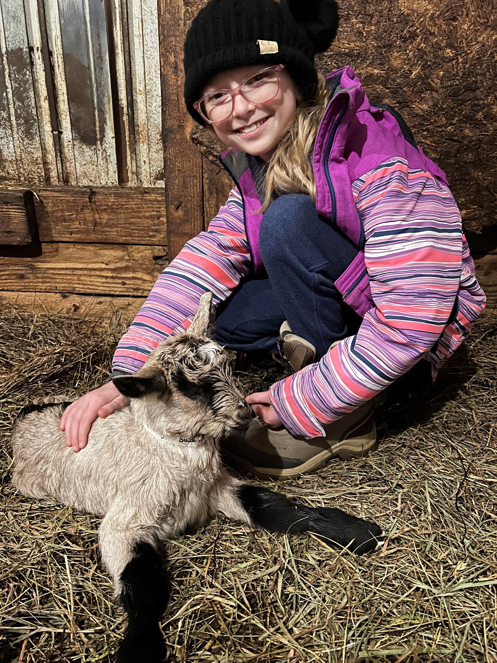
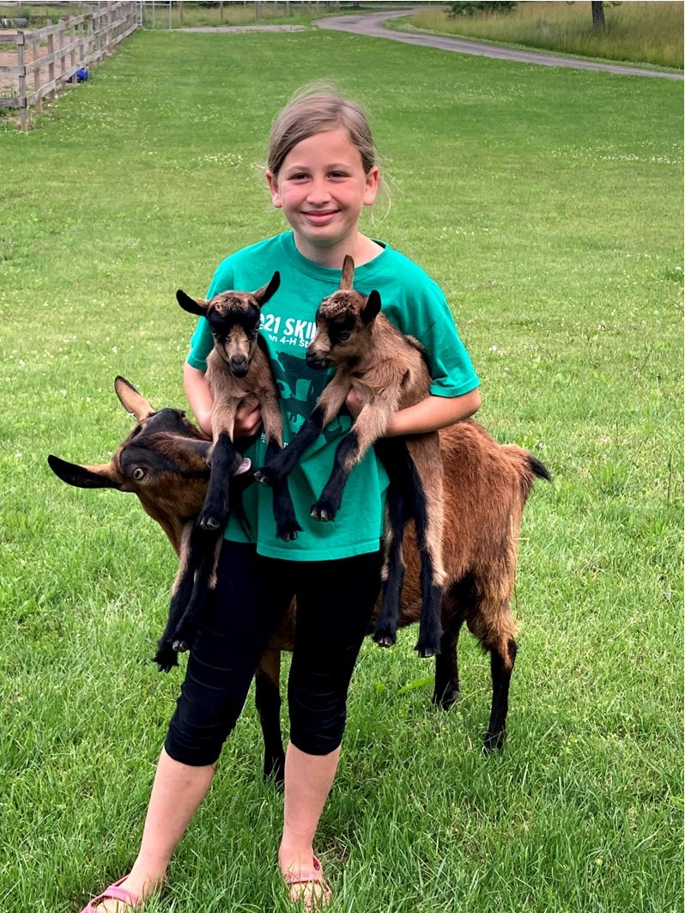
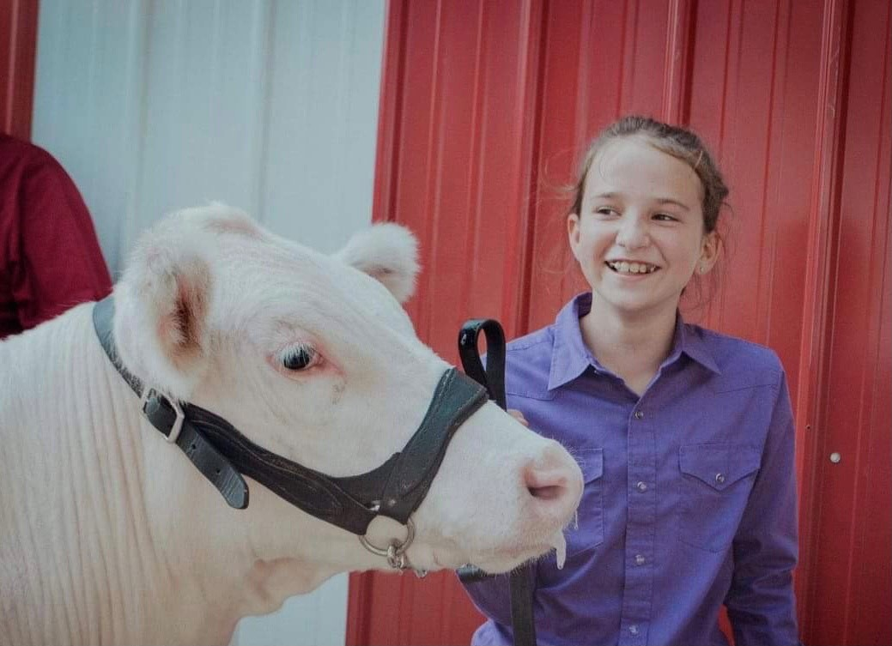
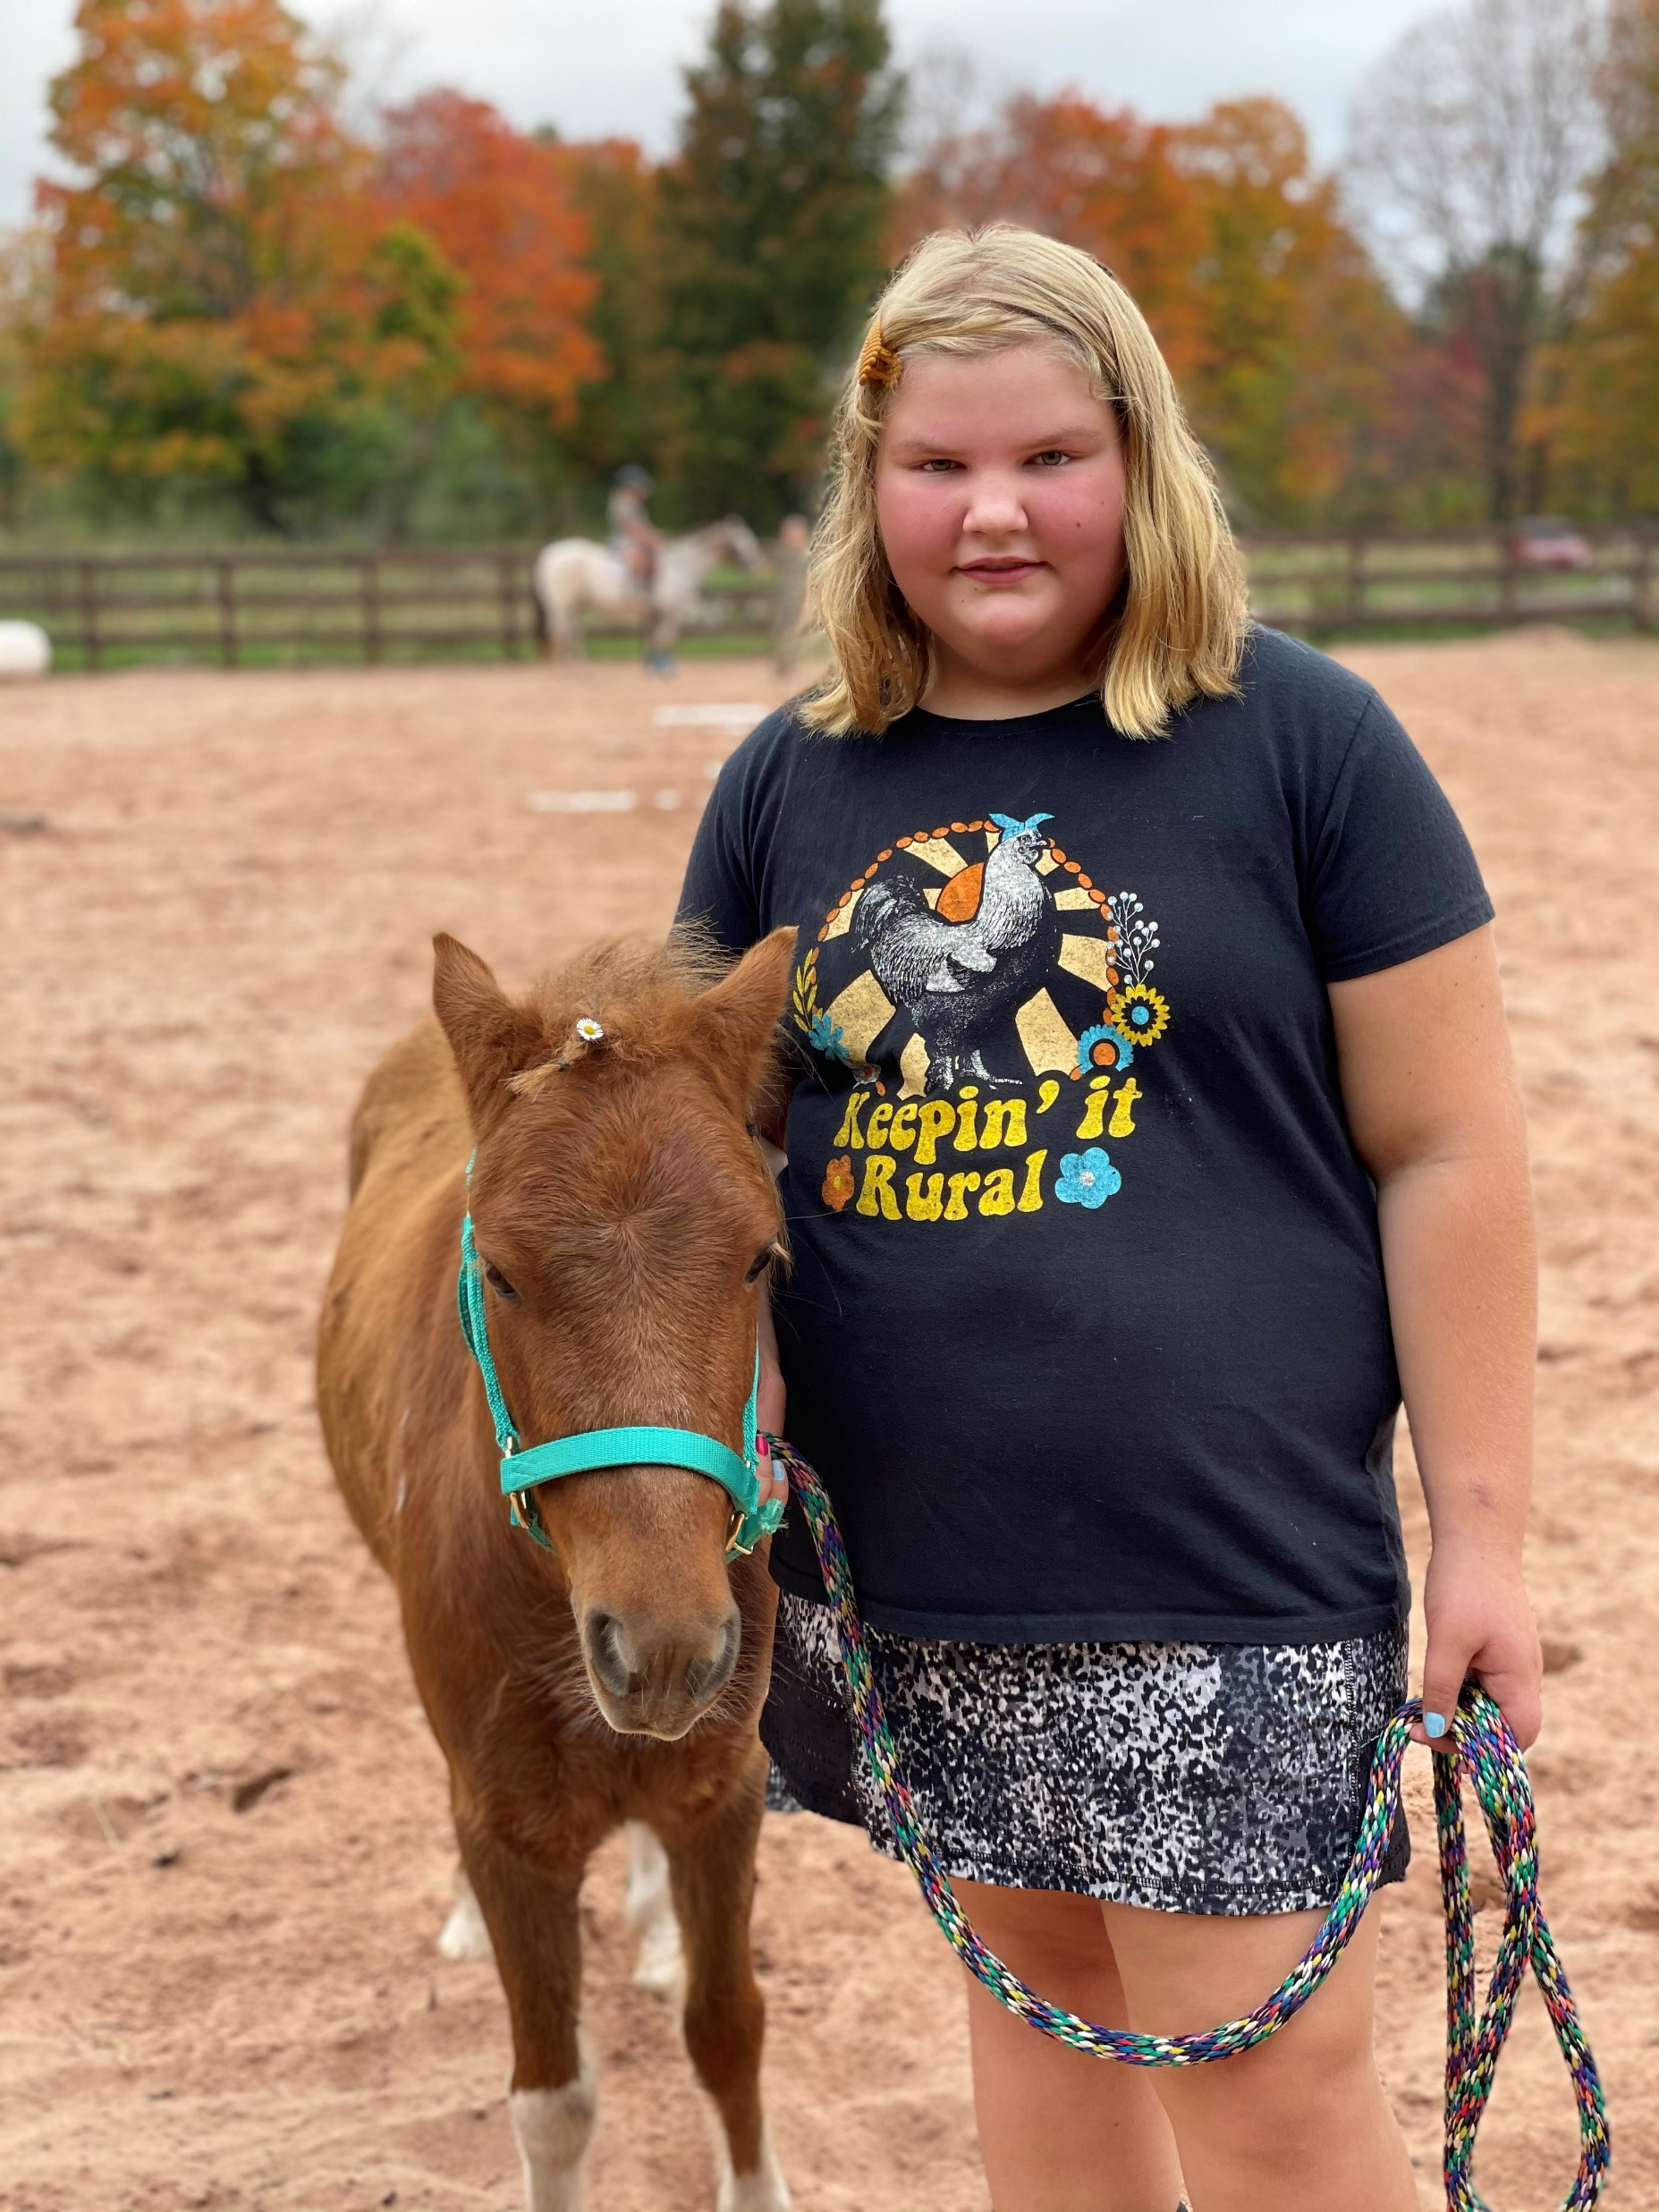
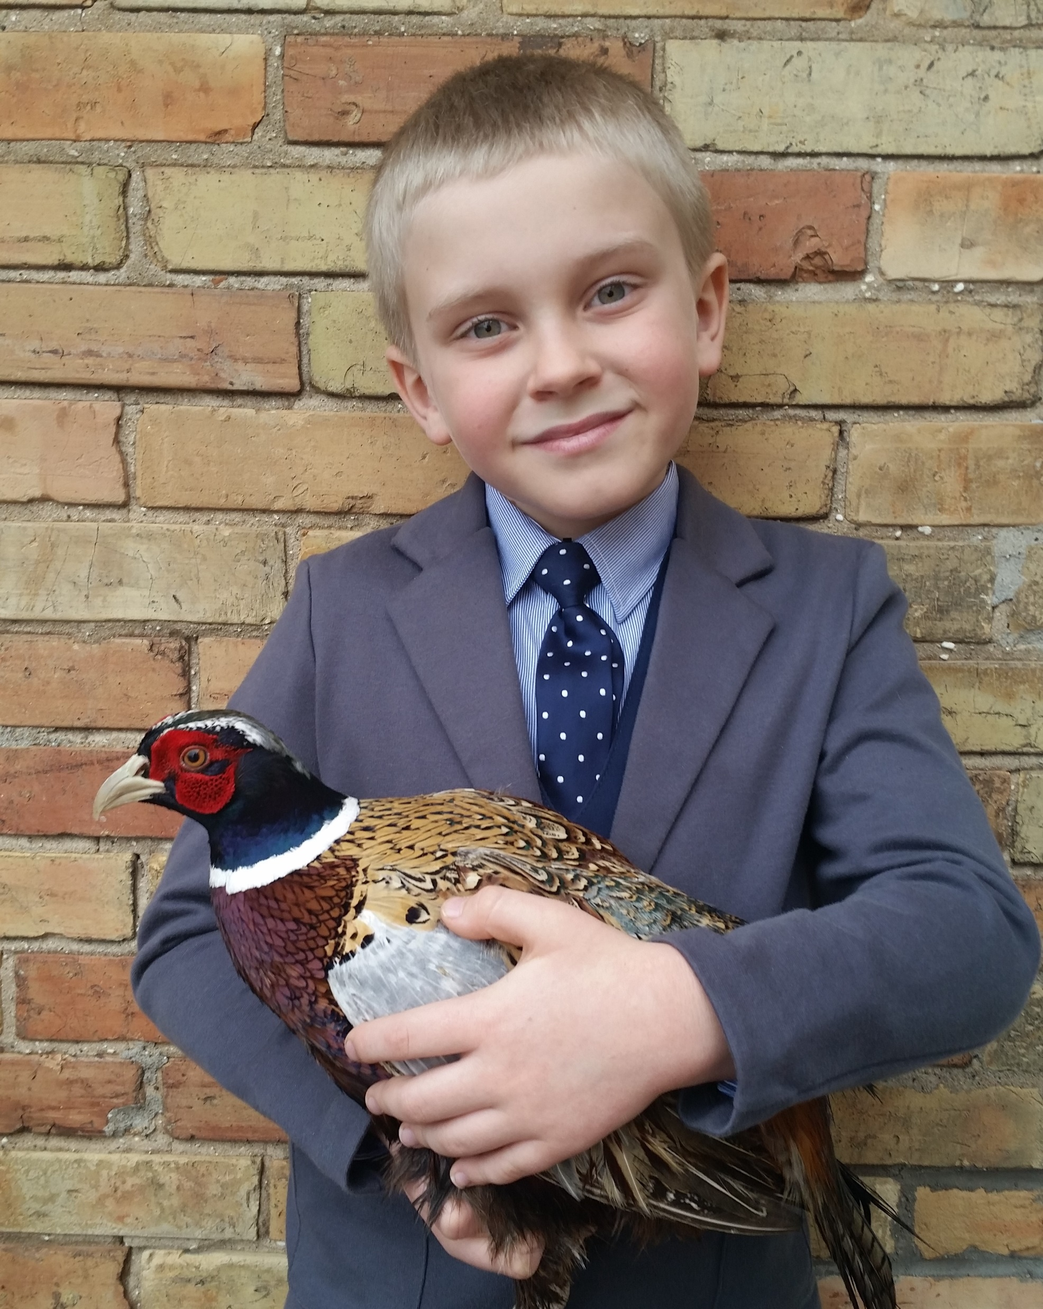
Novice Division
Colton Guy
Ionia
Bethani Schuiteman Manistee
Alivia Block
Ingham
Lillian Wasson
Grand Traverse
Mirayah Somero
Gogebic

Slide 24
2021 & 2022 Novice Champion
Lillian Wasson, Grand Traverse

Slide 25
Novice
Division

Slide 26
Thank You from the Skillathon Team!
Ali Olson 4-H PC - Benzie & Manistee
Angela Cook 4-H PC - Crawford
Ashley Dennis 4-H PC - Gogebic
Dave Radlof f 4-H PC - Delta
Emily Kotz 4-H PC - Grand Traverse
Geep Charlebois 4-H PC - Antrim & Otsego
Glenda Weiss 4-H PC - Ingham
Insa Raymond Academic Success - Hillsdale
Jacob Stieg 4-H PC - Osceola
Leah LaVanway 4-H PC - Charlevoix
Liana Pepin 4-H PC - Marquette
Lizz Duran 4-H PC - Macomb
Melissa Elischer 4-H Dairy Cattle Extension Educator - Main Campus
Michelle Eagling 4-H PC Alpena

Slide 27


